Slide 1
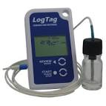

Entrenamiento en el LogTag
Enero 2015
Notes:
Welcome to the new LogTag training designed to walk you through the installation process for your LogTag data logger.

Slide 2
Contenido del entrenamiento en el LogTag
Lo necesario para instalar el LogTag
Instalación del software LogTag
Configuración del LogTag
Preparación del LogTag
Inicio del LogTag
Revisión diaria de las estadísticas
Alarma y excursiones de temperatura
Análisis de los datos provenientes del LogTag
Soluciones de problemas con el LogTag
Notes:
In this training session - we will cover the following: things needed to install the LogTag, preparing the LogTag, installing the LogTag software, configuring and starting the LogTag, reviewing daily statistics, alarm and temperature excursions, analyzing data from the LogTag and trouble-shooting the LogTag.

Slide 3

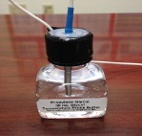

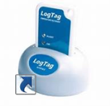
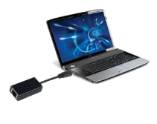
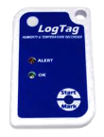
Lo necesario para instalar el LogTag
Acceso a Internet – Descargue el Software
Probe/Vial – Botella pequeña
Estación de carga (Dock)
Acceso directo al escritorio
Conectar a puerto USB
Log Tag
Notes:
There are a few things you will need to have in order to successfully install your LogTag.
You will need to have internet access to download the LogTag software. Once the software is installed, you will see the LogTag icon on your desktop.
You’ll also need the Probe/vial and small bottle.
Be sure that you have a LogTag docking station.
You will need access to an USB port on your computer
And of course, you will need the LogTag data logger!

Slide 4
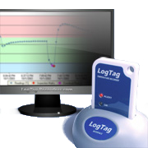
Instalación del software LogTag
Notes:
Our first section of this training is going to cover installing the software.

Slide 5
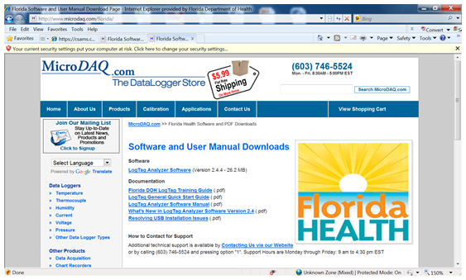

Abra el explorador de internet y diríjase hacia http://www.microdaq.com/florida/ para descargar el Software LogTag Analyzer
Notes:
Installing the LogTag software
Download the LogTag Analyzer Software by going to
www.microdaq.com/florida and then selecting the link for “LogTag Analyzer Software.

Slide 6
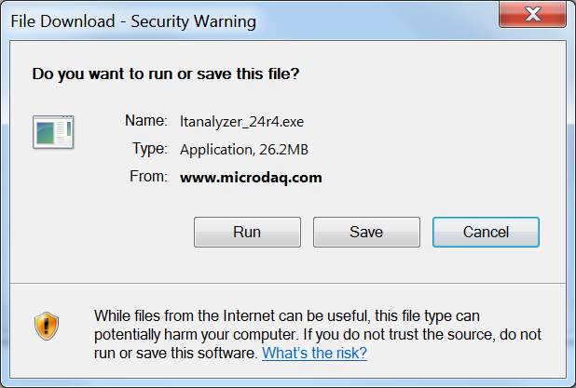
Haga clic sobre “RUN” para descargar el Software Analyzer
Notes:
Click “Run” to load the LogTag software.

Slide 7
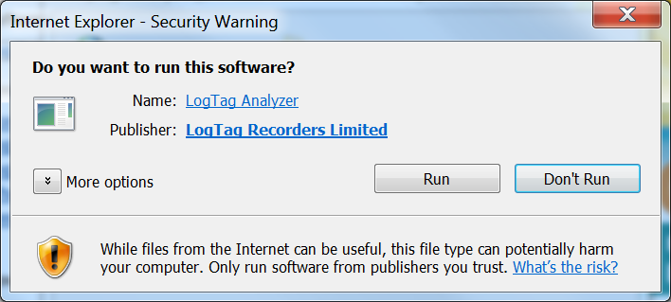
Luego haga clic sobre “RUN”
Notes:
Click “Run” when asked “Do you want to run this software?”

Slide 8
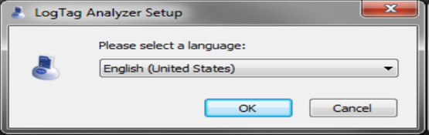
Cuando el LogTag Analyzer Set-up se abra, seleccione el lenguaje deseado y haga clic sobre “OK”
Notes:
When the LogTag Analyzer set-up opens, select the desired language from the drop-down menu then click on the “ok” button.

Slide 9
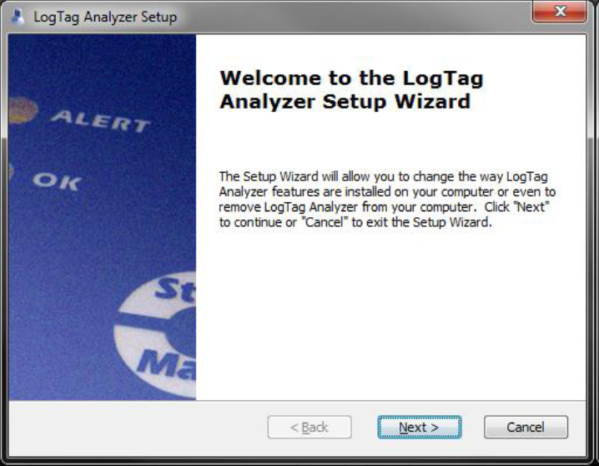
Haga clic sobre “NEXT” en la siguiente pantalla
Notes:
Next you will see this screen that says “Welcome to the LogTag Analyzer Set-up Wizard.” Click the “Next button.”

Slide 10
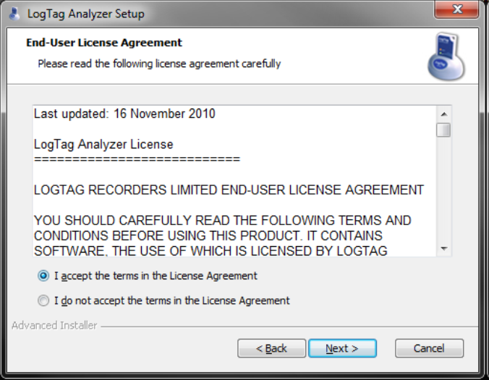
Seleccione “I accept the terms in the license agreement”. Haga clic sobre “NEXT” para aceptar el contrato de licencia de usuario.
Notes:
Click to accept the terms of the licensing agreement and then select “Next.”

Slide 11
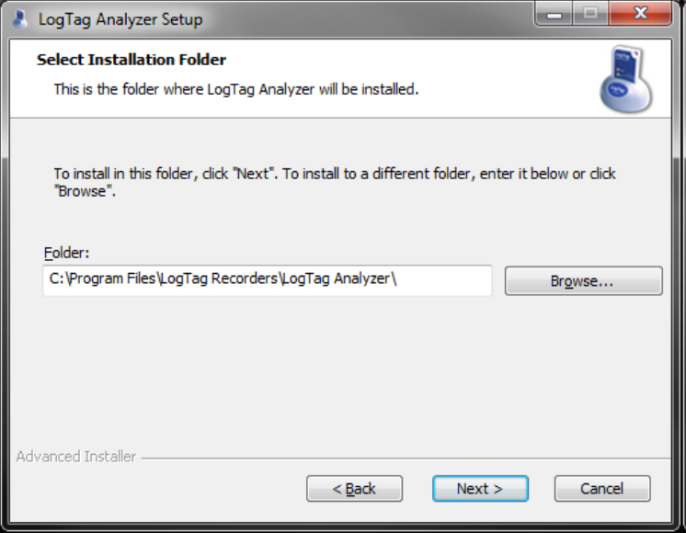
Acepte la carpeta que se muestre o haga clic sobre “BROWSE” para seleccionar otra carpeta. Luego haga clic sobre “Next”.
Notes:
The software will automatically generate and save in the location for you. If you want to change this location, you can click on the “browse” button and make your selection. Then, click “next.”

Slide 12
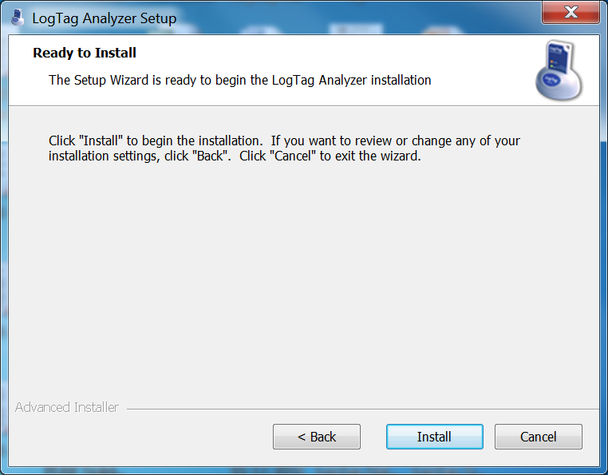
Haga clic sobre “INSTALL” para comenzar la instalación del LogTag Analyzer
Notes:
Now the setup wizard is ready to begin the LogTag Analyzer installation, begin this process by clicking the “install” button.

Slide 13
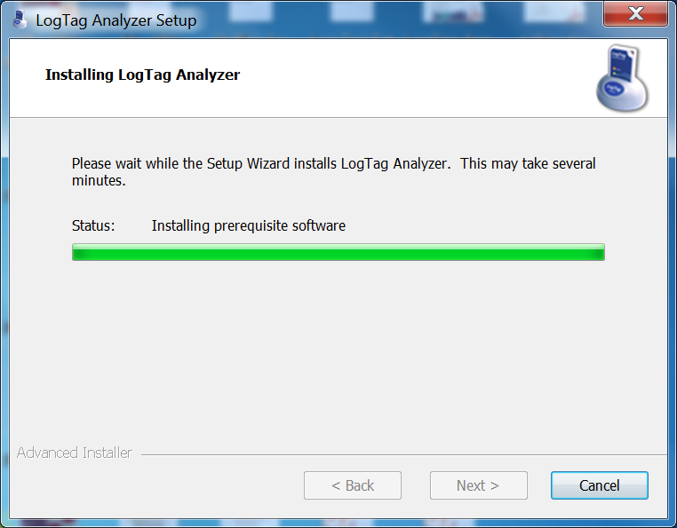
El progreso del proceso de instalación se indica mediante una barra verde
Notes:
The software will begin to install at this point. The green bar will indicate the installation progress.

Slide 14
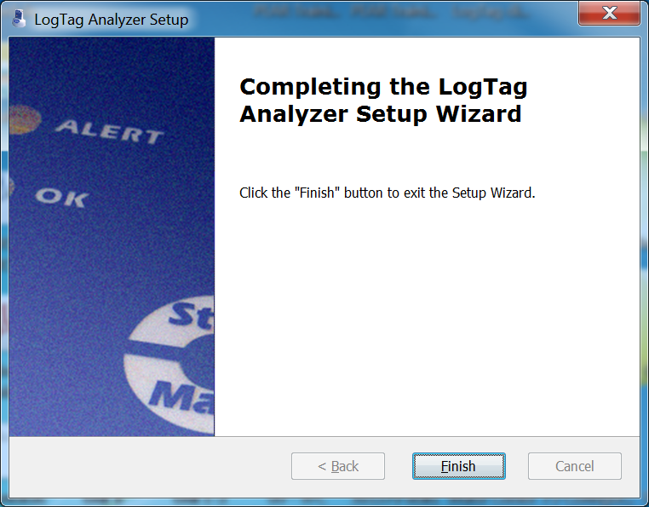
Haga clic sobre “FINISH”
Notes:
Click “finish” to exit the Setup Wizard.

Slide 15
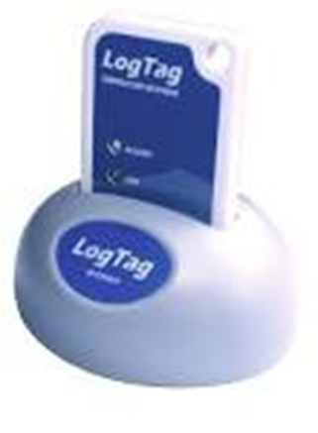
En el escritorio, busque el ícono del software del LogTag Analyzer recientemente instalado. Si no encuentra el ícono en el escritorio, entonces busque en el menú “START”
Notes:
Look for the newly installed LogTag Analyzer Software icon on your desktop. If you do not find the icon on your desktop, look for it in the start menu.
VERY IMPORTANT! One thing I want to mention here. If you click on the icon and the software does not load, you must uninstall the LogTag software from the computer and reinstall it by going back over the previous steps of the installation process.

Slide 16
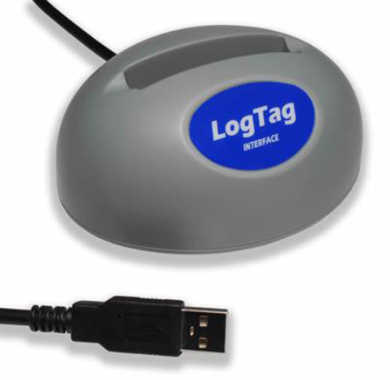
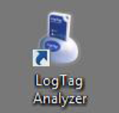
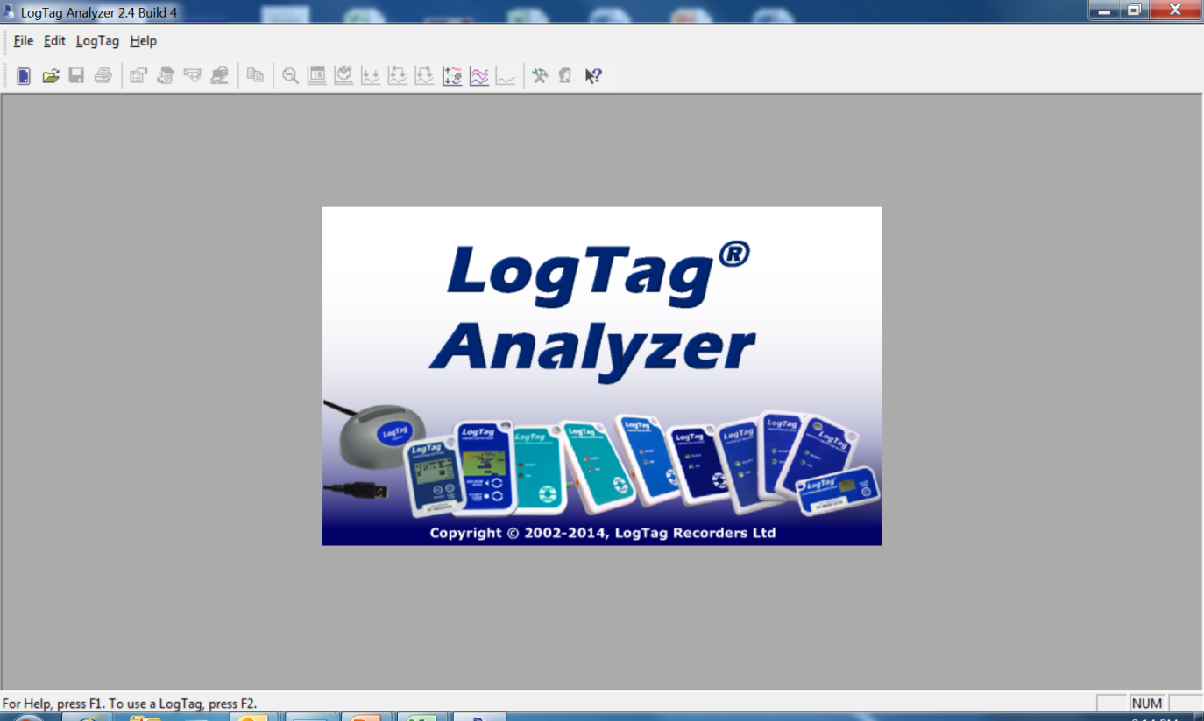
En el escritorio, busque el ícono del software del LogTag Analyzer recientemente instalado. Si no encuentra el icono en el escritorio, entonces busque en el menú “START”
Notes:
Locate the icon and double-click on it. Again, if you do not see it on your desktop, look in your start menu for “LogTag Analyzer.”.

Slide 17

Configuración del LogTag
Notes:
Now it is time to configure or “tie” the LogTag to the software.

Slide 18
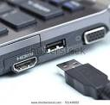

Notes:
Insert the USB end of the docking station into the USB port on the computer or laptop. After plugging in the docking station for the first time, the system will install drivers for the device and should notify you as this occurs. Please allow a moment for this to complete.”

Slide 19

Notes:
Insert the LogTag into the docking station with the digital screen facing forward, until it clicks.

Slide 20
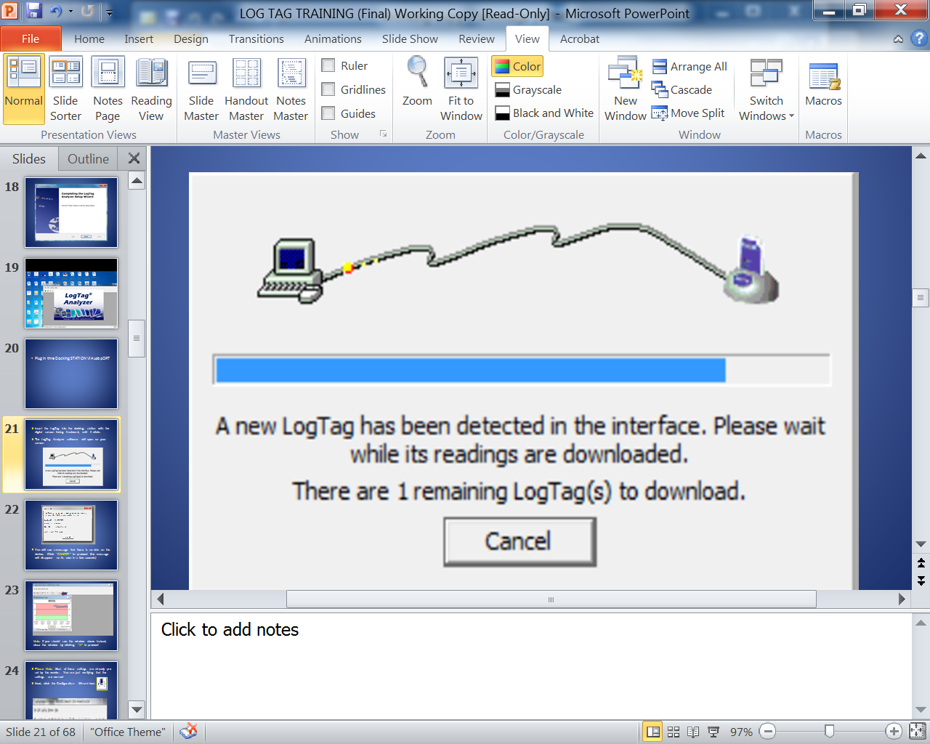
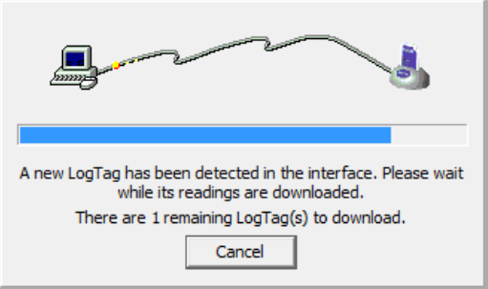
Insert the LogTag into the docking station with the digital screen facing frontward, until it clicks
The LogTag Analyzer software will open on your screen
Notes:
The picture on this screen is an indicator that the docking station is connected to the computer.

Slide 21
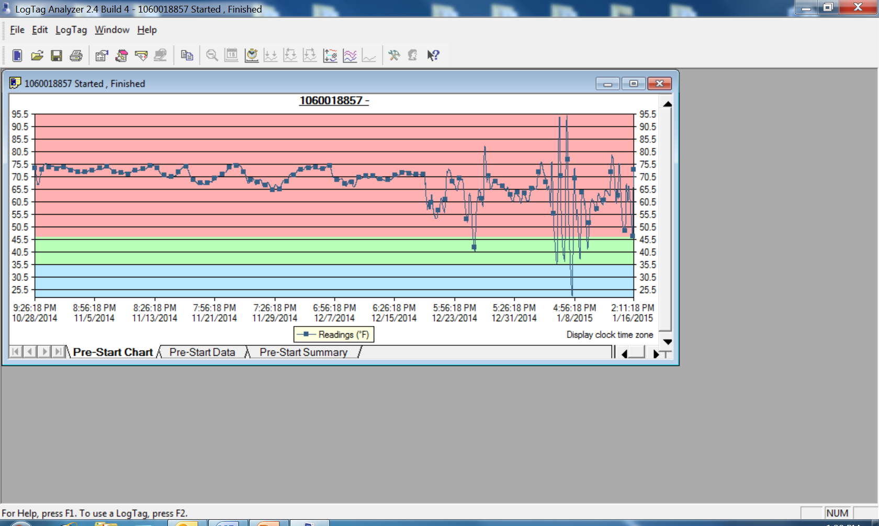

Slide 22
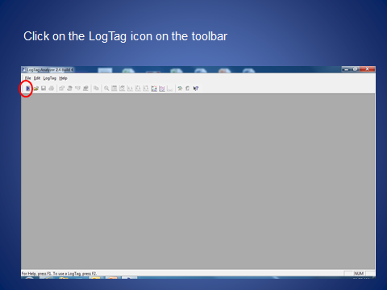
Haga clic sobre el ícono LogTag que se localiza en la barra de herramientas
Notes:
Now click on the LogTag icon in the upper left corner of your screen – it looks like a tiny cell phone.

Slide 23
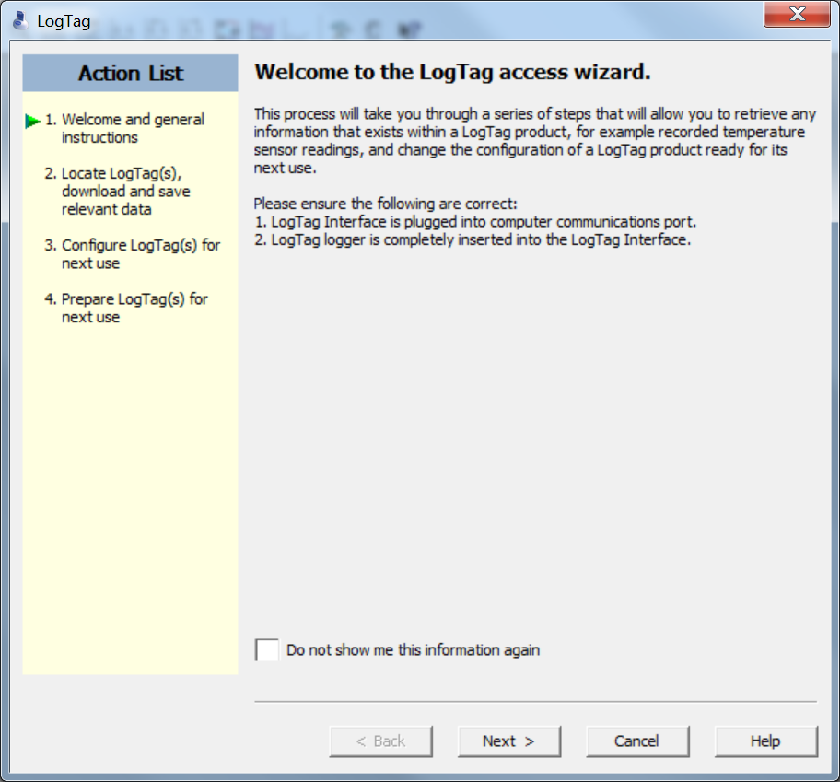
Haga clic sobre “NEXT”
Notes:
When this screen comes up – click “next”

Slide 24
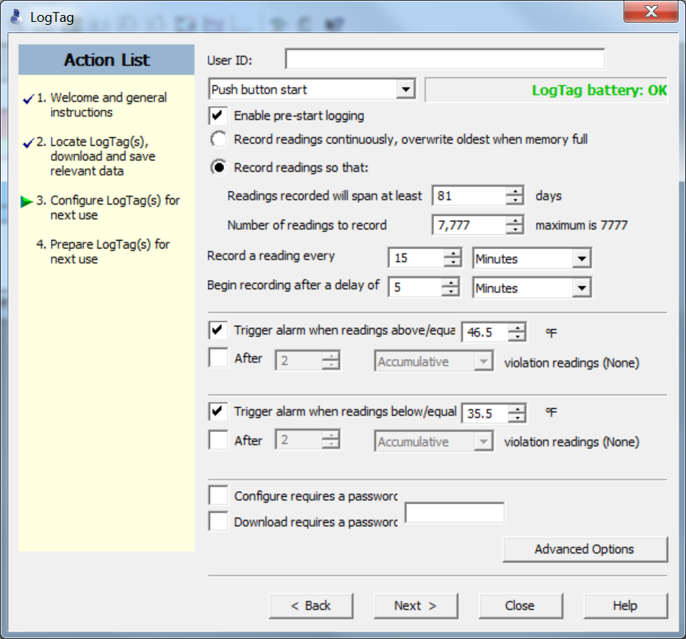
Notes:
You should have a screen now that looks like this one.
The first thing that needs to be done is you will need to give it a User ID on the first line indicated by the red arrow on your screen.
When assigning the User ID, use the format of PIN-FREEZER (or whatever name such as “breakroom” or just something easy to remember or PIN-REFRIGERATOR and a number at the end if you have more than one of that type of unit. It is imperative that the names of the unit are identical to what you current in Florida SHOTS or your data will not upload.
Everything else on this page is pre-configured – just check to ensure that your page is exactly like the page appearing on the screen.
Be sure and leave the password options blank – and DO NOT click on “next” yet. Now, click on “Advanced Options.”

Slide 25
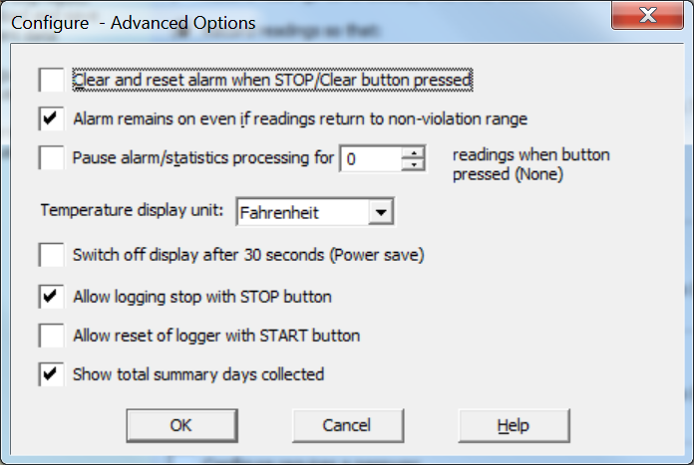
Notes:
On the Configure – Advanced Options screen – the settings are pre-configured. Select “Fahrenheit” for the Temperature Display Unit and then click on the “ok” button.

Slide 26
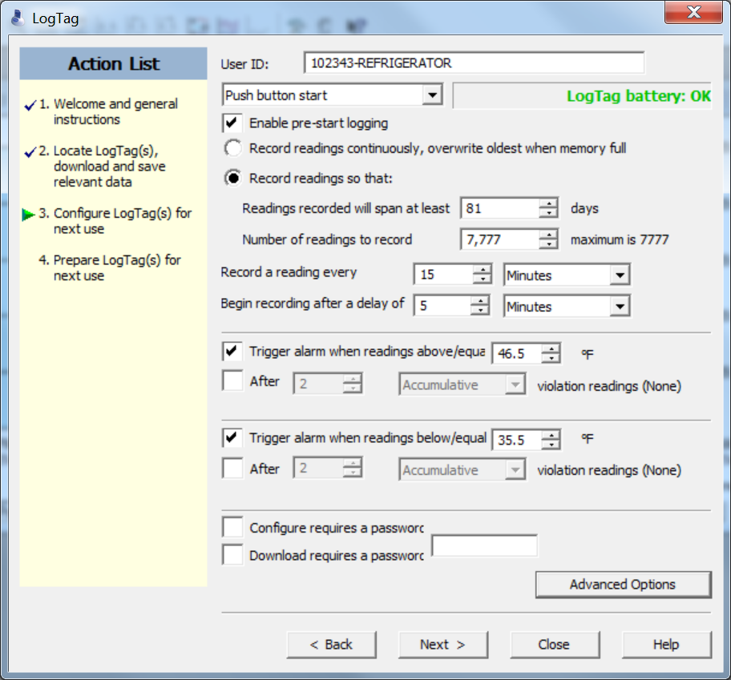
Notes:
Click the “next” button.

Slide 27
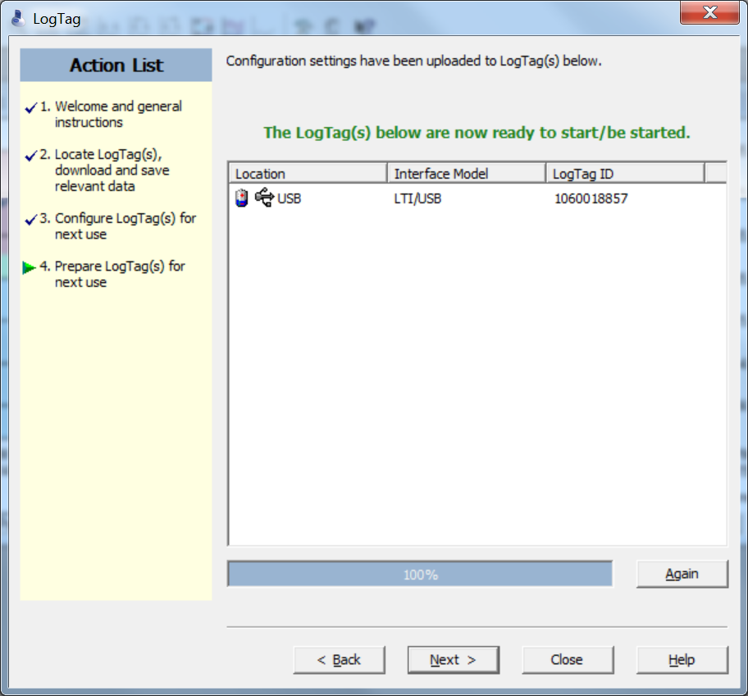

Slide 28
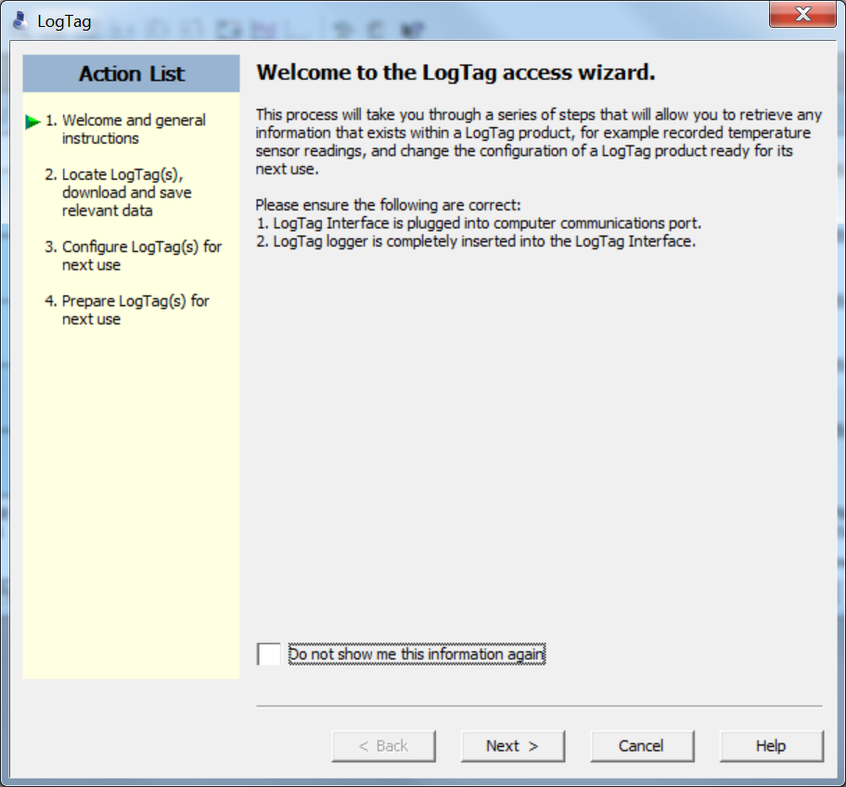
Notes:
Then click “next” to continue.

Slide 29
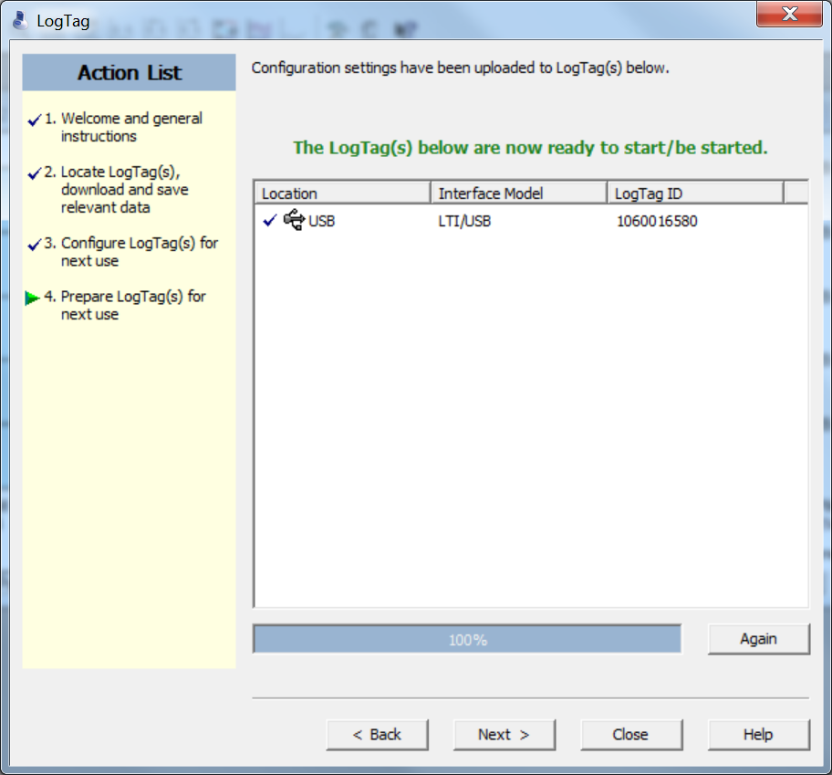
Notes:
Click “NEXT” and on the next screen select “CLOSE”. Now would be a good time to any other LogTag devices which need to be set-up for use. This configuration process is also used to “reset” a LogTag device after each successful download.

Slide 30
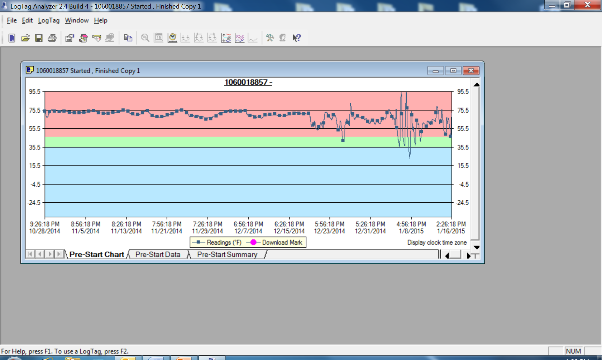

Slide 31
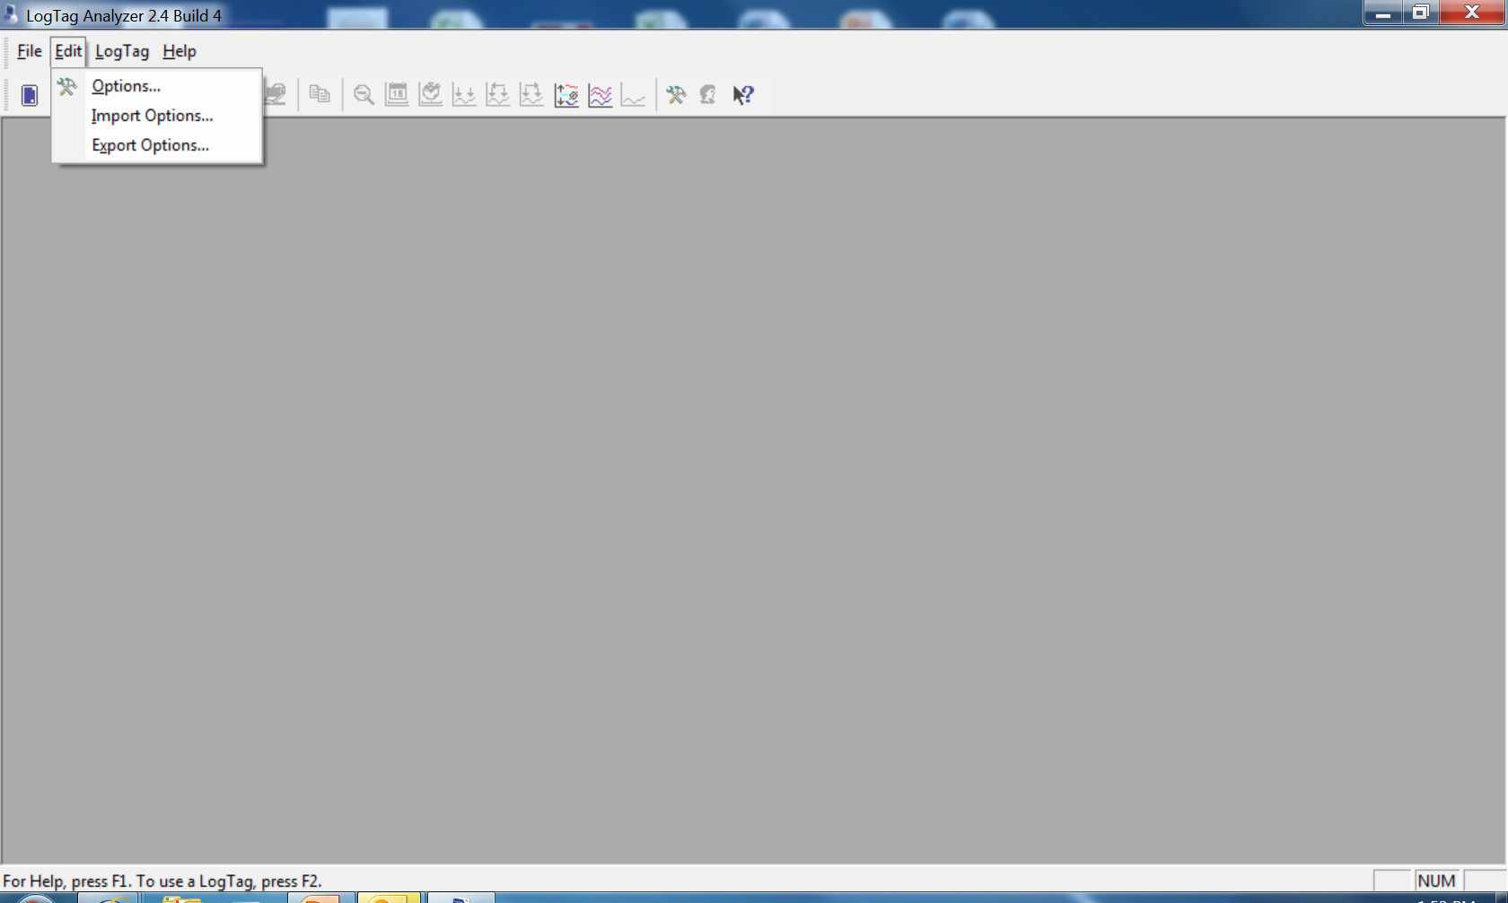
Notes:
Now from the menu bar at the top of this page, click “edit” then select “options.”

Slide 32
En el menú principal, haga clic sobre “EDIT”, luego seleccione “OPTIONS”
En el menú de la izquierda, haga clic sobre “GENERAL SETTINGS”
Muestre las temperaturas en “FAHRENHEIT”
Notes:
A list will appear on the left, click on “general settings” which appears at the top of the list and confirm the “show temperatures” and select “Fahrenheit.”

Slide 33
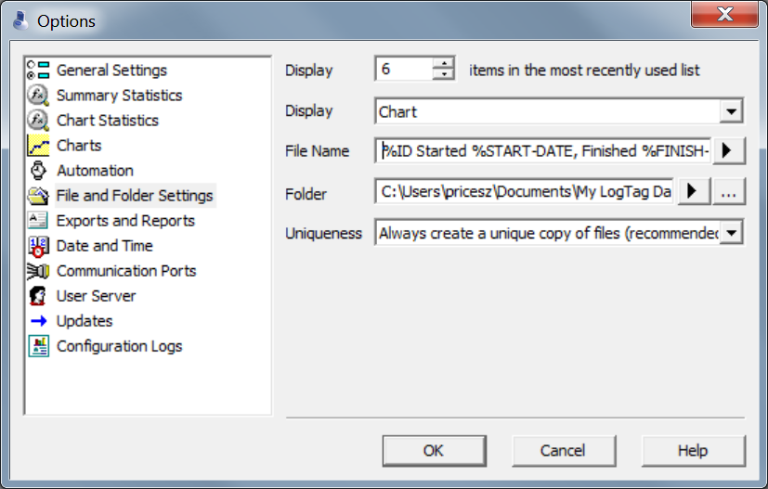
En el menú de la izquierda, haga clic sobre“FILE AND FOLDER SETTINGS”
En la casilla correspondiente a “FILE” escriba lo siguiente:
%ID %STARTED %START-DATE, Finished %FINISH-DATE
Notes:
Then move down to the “File and Folder Setting” on the “file” line type
%ID %STARTED %START-DATE, Finished %FINISH-DATE
Now this file name is a little different than the first version in the power point put together by Microdaq. I spoke with IT in our office and he said that either one will work. I would say not to worry about those that have been set up using the old version because this will not cause a problem with uploading to Florida SHOTS. Going forward, this is what should be used – for consistency among the field staff.

Slide 34


En la casilla correspondiente a “FOLDER”, seleccione la carpeta en la que el usuario guardará los archivos de datos provenientes del LogTag
Dicha carpeta necesita ser accedida por múltiples usuarios, por lo que lo ideal es que la carpeta se localice en una unidad compartida. Si existen múltiples usuarios para la misma computadora, el escritorio podría ser utilizado con este propósito. Haga clic sobre “…”
Seleccione la unidad donde los archivos del LogTag serán guardados. Si la carpeta del LogTag ya existe, haga clic sobre “…”
Notes:
On the “Folder” line, select a place where the user will save the LogTag data files.
It is VERY important to note that the place selected to save the LogTag data files needs to be accessible to multiple users – so a shared folder is ideal.
Then select the drive where the LogTag data files will be stored. If a LogTag already exists there, click on the “…” button, a “locate folder” box will appear.

Slide 35
Seleccione la unidad donde los archivos del LogTag serán guardados. Si la carpeta LogTag ya existe, haga clic una vez para seleccionarla, y luego haga clic sobre “OK”
Si no existiese una carpeta, haga clic sobre “MAKE NEW FOLDER”, nómbrela LogTag, y luego haga clic sobre “OK”
Notes:
From that list, you may now select the drive where the LogTag files will be stored. If a folder already exists – click once to select it then click on “ok.”
If the folder was not yet created, click on “make new folder”, name it LogTag, then click “ok.”

Slide 36
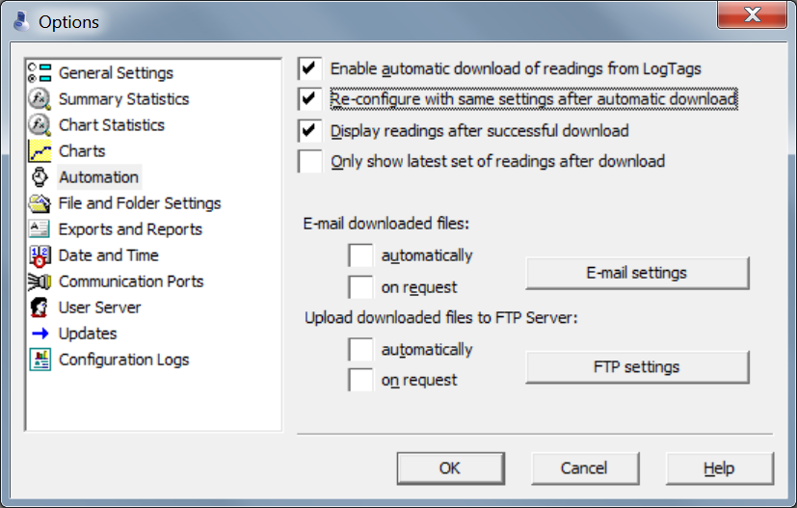
Notes:
Click the second box “Re-configure with same settings after automatic download”, then click on “OK”.

Slide 37
Configuración de los perfiles de usuarios

Slide 38
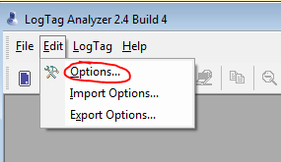
PERFILES DE USUARIOS:
Abra el software LogTag Analyzer
Seleccione “Edit” y luego “Options”
Notes:
Open the LogTag software, then choose “edit” then “options”

Slide 39
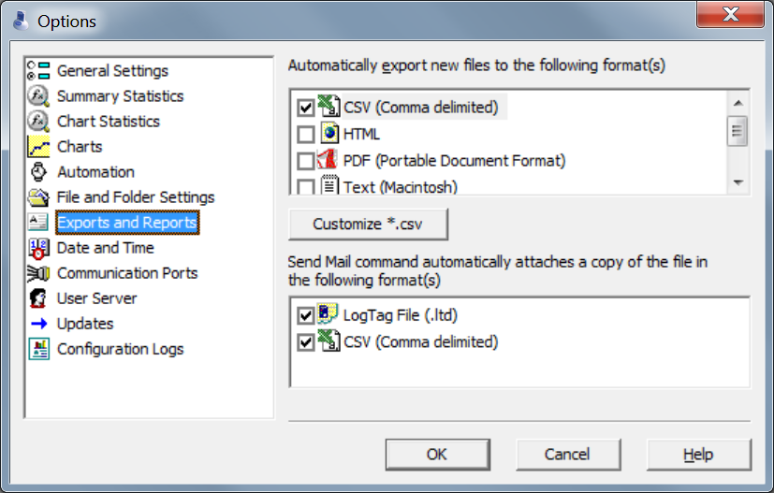
Seleccione “Exports and Reports”
Haga clic sobre Customize *.csv
Notes:
Click on “Exports and Reports”, check the box next to “CSV” then the “customize CSV” button.

Slide 40
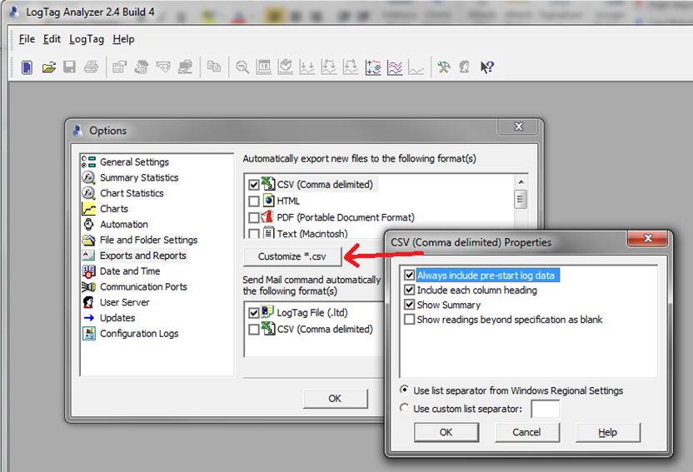

Slide 41

Preparación del LogTag
Notes:
Preparing the LogTag

Slide 42
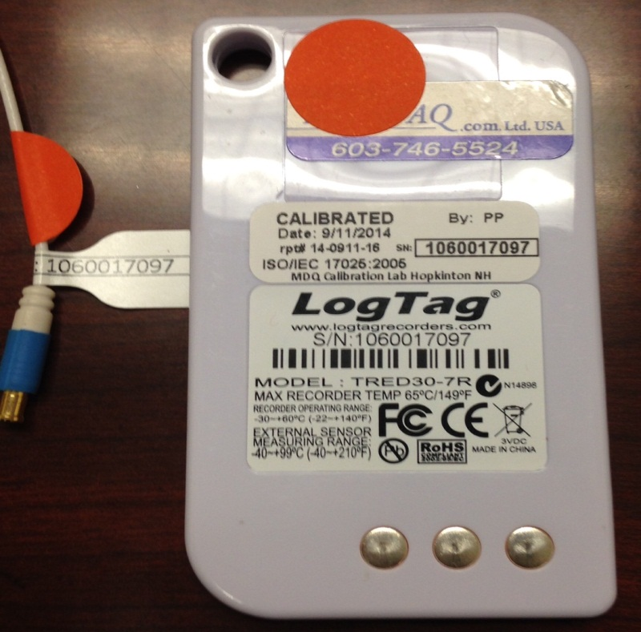

IMPORTANTE: Asegúrese que el Probe y LogTag tengan el mismo número de serie y código de colores. Inserte el Probe en el LogTag
Notes:
It is very important that the serial numbers on the LogTag and the probe match. There are color-coded dots that will assist you in matching up the LogTag and probe. Once the serial numbers are verified, plug the probe into the LogTag.

Slide 43
Coloque el vial en una bandeja de plástico (si la rejilla es de metal) en el centro de la unidad del refrigerador o congelador y asegúrelo con cinta adhesiva o velcro
Saque el cable del probe a través de la bisagra de la puerta del refrigerador
Permita que el probe/vial se normalice en el refrigerador/ congelador por 1 1/2 a 2 horas antes de iniciar el LogTag
Notes:
Next, place the vial in a plastic tray – if placing it on a wire rack – and put it in the center of the middle rack of the unit and secure with tape or Velcro.
Run the probe cable through the hinge side of the door.
It is important to be sure and allow the probe/vial to normalize and approximate vaccine temperatures in the unit for 1 ½ - 2 hours before starting the LogTag.

Slide 44
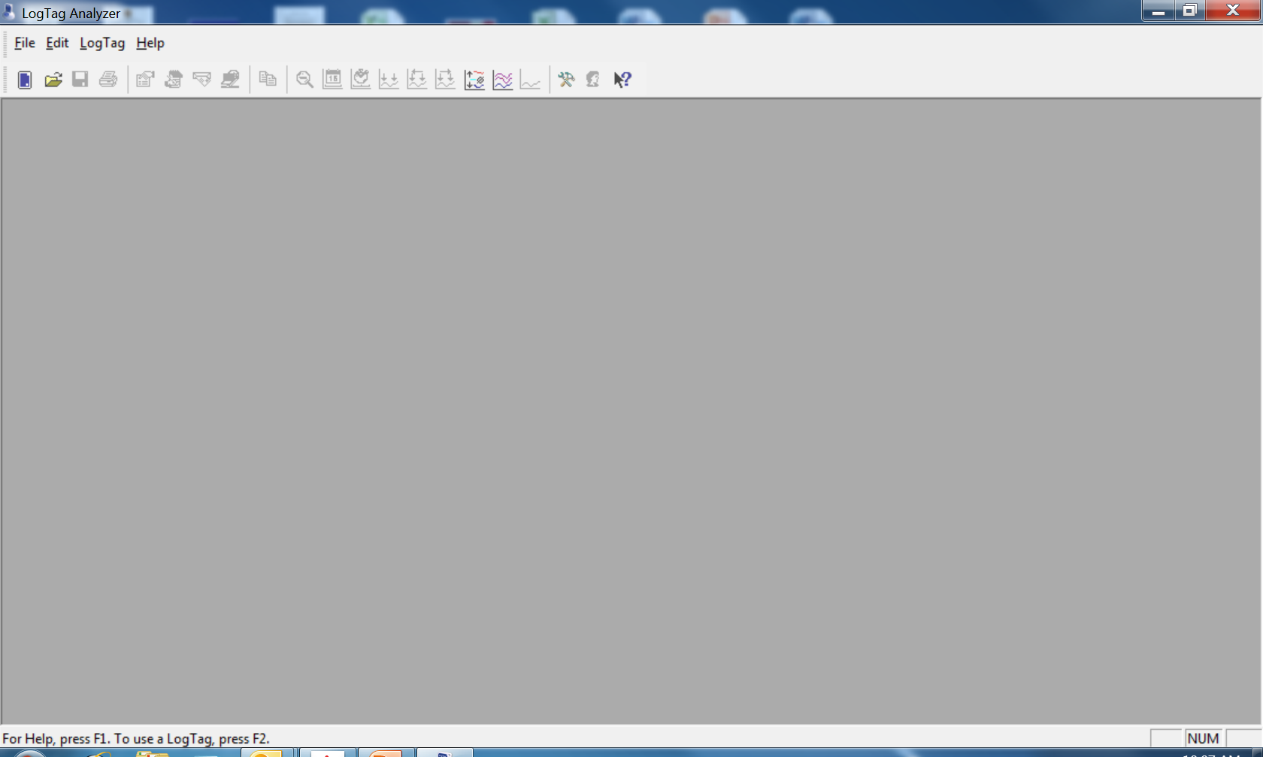
Ya el LogTag se encuentra totalmente configurado y listo para usar. Haga clic sobre “OK” y remueva el LogTag de la estación base
Haga clic sobre “X” en la esquina superior derecha de la página para cerrarla
Notes:
The LogTag is now fully configured and ready to be used. Click “ok” and remove the LogTag from the docking station.
Click the “X” in the upper right corner to close this page.

Slide 45
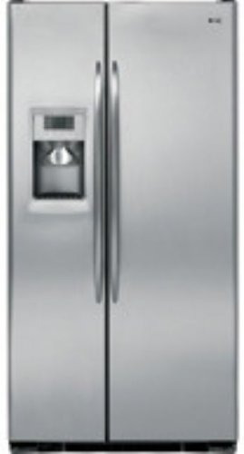
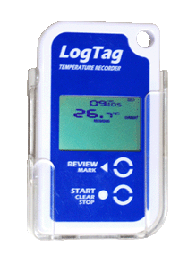
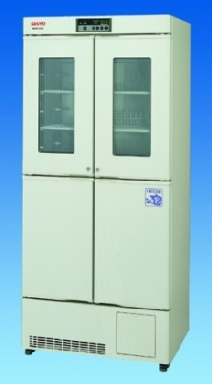
Identifique la localización fuera del refrigerador o congelador donde desea montarlo
Asegúrese de que el lugar seleccionado se encuentre al alcance de los probes de los refrigeradores o congeladores y se encuentre fácilmente accesible
Adhiera el LTI-MOUNT (plástico transparente de soporte) utilizando la cinta adhesiva de doble contacto (localizada en cada equipo de soporte)
Inserte el LogTag dentro del equipo de soporte SIN el probe adherido
Notes:
Decide the desired mounting location on the outside of the unit, ensuring that the probe will reach and that the mounting location of the LogTag is easily accessible.
Attach the clear plastic LTI-mount using double-sided tape.
Then, slide the LogTag into the mount WITHOUT the probe attached.

Slide 46
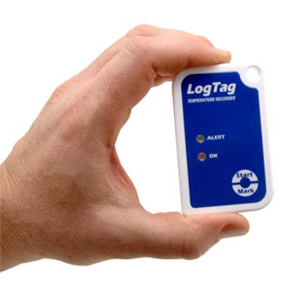
Inicio del LogTag
Notes:
This section is about “Starting the LogTag.”

Slide 47
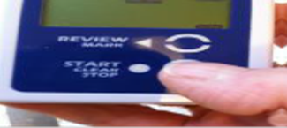
Una vez configurado, la pantalla deberá leer “READY”
Presione el botón “START” y manténgalo presionado hasta que “STARTING” deje de parpadear
Notes:
The LogTag is now configured and should read “ready.”
Press and hold the “start” button, then release the button when “starting” stops flashing on the screen.

Slide 48
Existe una demora de 5 minutos antes de que el LogTag de la unidad de almacenamiento comience a registrar.
Regrese el LogTag al equipo de montaje y conéctele el probe.
Notes:
It is important to note that there is a 5 minute delay before the LogTag begins recording. This is a good time to return the LogTag to its holder and plug in the probe.

Slide 49
En la pantalla del registrador se debe leer “Recording“
Presione una vez el botón “review” (arriba)
El LogTag mostrará la temperatura
máxima de ese día
(Day 00=fecha actual)
Notes:
On the LogTag display, you will see “recording.” Press the “review” button at the top once.
The LogTag will display today’s max temperature.

Slide 50
Presione “REVIEW” una vez más y la pantalla mostrará la temperatura mínima del día
Una vez que haya terminado de revisar las temperaturas, presione “STOP” una vez
Notes:
To display today’s minimum temperature, press the “review” button once again. When you are done reviewing temperatures, press the “stop” button.

Slide 51
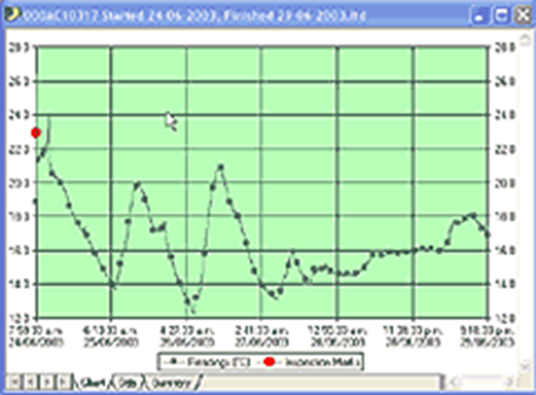

Revisión diaria de las estadísticas

Slide 52
El LogTag debe todavía mostrar “RECORDING”
Presione “REVIEW” para añadir un “Inspection Mark” al registro
Esto muestra que ha revisado las lecturas de temperatura para ese día
Dicha acción debe ser realizada dos veces al día para cada LogTag. Esta acción reemplaza la necesidad de mantener registros de temperatura por escrito
Puede revisar las temperaturas mínimas y máximas registradas durante los 30 días previos a la fecha actual
Notes:
When reviewing the daily statistics, the LogTag should still show “recording”.
By pressing the “review” button you are placing an “inspection mark” on the record. This shows you have reviewed the temperature readings for that day.
This should be done twice daily for each LogTag.
I need to mention something very important here. When recording an inspection mark right before docking - you MUST hit review, wait 15 minutes, stop it (to where stopped is no longer flashing) before disconnecting the probe and place in the docking station - or your last inspection marks will not record and the LogTag will generate an error message which will prevent it from uploading into Florida SHOTS.
Attach the LogTag to the probe BEFORE you hit START (by holding the START button until the word START is no longer flashing and the word STARTED holds steady on the display) to begin taking temperatures again with the LogTag.
You are required to keep paper logs and/or temperature readings entered into Florida SHOTS for three years. Once the twice daily temperatures are entered into Florida SHOTS utilizing either a data logger or manual entry methods, going forward – you will not have to maintain the paper logs anymore. Remember that you must have three years of the paper logs or twice daily temperature readings entered into Florida SHOTS – OR a combination of the two. As time passes and temperature readings are entered into Florida SHOTS, you will be able to begin to discard the older paper logs gradually – as you are required to just keep the last 3 years.
You can review the minimum and maximum temperatures for up to the previous 30 days recorded.

Slide 53
Una vez que haya revisado las temperaturas mínimas y máximas de la fecha actual, si presiona “REVIEW” una vez más se mostrará la temperatura máxima del día anterior (Day -1). Cualquier lectura fuera de rango será indicada
Notes:
After reviewing the current day’s minimum and maximum temperatures, pressing the “REVIEW” button once again will show yesterday’s (Day -1) maximum temperature. Any out of range readings will be indicated.

Slide 54
Al presionar nuevamente “REVIEW”, se mostrará la lectura de temperatura mínima del día anterior (Day -1)
Notes:
Then, press “review.”

Slide 55

Al presionar “REVIEW” nuevamente se mostrará la lectura máxima de los dos días anteriores a la fecha actual (Day -2) etc…
Presione “STOP” en cualquier momento para salir del modo de revisión “REVIEW Mode”
Notes:
By pressing “review” again, the LogTag will display the maximum reading for 2 days ago. You can press the “stop” button at any time to exit “review mode”

Slide 56
Como ver y salvar los datos
Extraiga el LogTag del soporte
Presione y mantenga presionado el botón “START/CLEAR/STOP
Cuando “stopped” deje de parpadear, libere el botón y verá “stopped” en la pantalla
Desconecte el probe
Es importante que los números de serie del LogTag y el probe coincidan
Abra el software LogTag y coloque el LogTag en la estación base
Notes:
To view/save LogTag data – first, slide the LogTag out of the mount.
Stop the recording process by pressing and holding the “start/clear/stop button.
When “stopped” is no longer flashing, release the button and you should see “stopped” on the screen.
Carefully unplug the probe from the LogTag.
It is important that the LogTag and probe serial numbers match
Open LogTag software and place the LogTag into the docking station

Slide 57
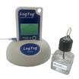
Alarmas y Excursiones de Temperatura
Notes:
Alarms & Temperature Excursions

Slide 58

Su LogTag ha sido configurado para registrar las temperaturas de una unidad en específico (refrigerador o congelador)
Cuando la temperatura registrada se encuentre por encima o por debajo del rango de temperaturas recomendado para la unidad, el LogTag mostrará una advertencia
La palabra ALARM comenzará a parpadear en la pantalla del LogTag
La flecha hacia arriba indica que la temperatura está muy alta para la unidad
La flecha hacia abajo indica que la temperatura está muy baja para la unidad
Notes:
Your LogTag has been configured to record temperatures for a specific unit, either R/F
When a recorded temperature is above or below the recommend temperature range for the unit, the LogTag displays an alarm warning
The word ALARM flashes on the LogTag’s screen
The up arrow indicates the temperature is too warm for the unit
A down arrow indicates the temperatures is too cool

Slide 59
  Una vez que la temperatura haya regresado a un rango aceptable podrá borrar el mensaje de alarma
  Presione “STOP” hasta que la palabra “ALARM” pare de parpadear
  Libere el botón “STOP” en menos de 2 segundos
  La palabra “ALARM” deberá desaparecer de la pantalla, sin embargo la palabra “TODAY” aparecerá indicando que ha ocurrido una excursión de temperatura en dicha fecha.
Notes:
Once the temperature has returned to acceptable range, you can clear the alarm
Press and hold the STOP button until ALARM stops flashing
Release the STOP button within 2 seconds
The word ALARM should disappear from the screen, but TODAY will appear, indicating that there was a temperature excursion today

Slide 60
Al día siguiente, aparecerá el mensaje “-1 day” indicando que la alarma fue activada el día anterior
Notes:
Tomorrow, there will be a message showing “1-day”, indicating that there was an alarm yesterday

Slide 61
Este mensaje se continuará mostrando por 30 días, indicando todas las veces que la alarma fue activada durante ese periodo de tiempo (en el siguiente ejemplo, la alarma se activó varias veces en varios de los días anteriores: el día anterior (-1day), 8, 20, 21 y 26 días anteriores)
Notes:
This message will continue to show for up to 30 days, indicating all the alarms that occurred during that 30-day time period. (In this below, there were several alarms that occurred: yesterday (1-day), 8 days ago, 20 days ago, 21 days ago and 26 days ago

Slide 62
El valor mostrado indica lo siguiente :
  TIME = Muestra el tiempo actual (READY & RECORDING modes)
  TIME DELAY = Muestra el tiempo que queda para comenzar los registros una vez que el tiempo “DELAYED START” haya sido configurado (STARTING MODE)
Notes:
The value displayed is indicated by the following:
TIME = Displaying Current Time (READY & RECORDING modes)
TIME DELAY = Displaying remaining time to recording start when a DELAYED START time has been configured (STARTING MODE)

Slide 63
DURATION = Muestra la duración de una estadística MAX/MIN dada por encima/debajo del límite en un día determinado
Estado de la batería– Muestra el estado de la batería cada una hora
Notes:
DURATION = Displaying duration of a given MAX/MIN statistic above/below the limits in a given day (REVIEW MODE)
Battery status – Performs battery test hourly

Slide 64
Cuando el LogTag es insertado en la estación base los datos son automáticamente descargados y salvados en la computadora
El gráfico que muestra el periodo de tiempo en el que el LogTag estuvo activado, se muestra por defecto
Se indican los registros desde 26/9/14 hasta 1/10/14
Notes:
When the LogTag is inserted into the dock it’s data is automatically downloaded and saved to your computer
By default, a chart is displayed showing the time period that the LogTag was active

Slide 65
La línea azul grafica todas las temperaturas registradas durante este periodo
El rango de temperatura se muestra en el eje de la izquierda
La fechas y hora se muestra en el eje x
Si se para con el ratón sobre cualquier punto del gráfico podrá ver el tiempo y la temperatura registrada para dicho punto
Puede cambiar la pantalla haciendo clic sobre una de las pestañas en la parte inferior. La pestaña mostrada en la imagen corresponde a “CHART”
Notes:
The blue line is charting all of the recorded temperatures during this period
The temperature range is shown on the left
Times and dates are along the bottom
You can hover with your mouse over any point on the graph to see the time and temperature recorded

Slide 66
Si hace clic sobre “REPORT” podrá ver el reporte que resume toda la información para este periodo
Al hacer clic sobre “DATA”, se mostrará un reporte detallado de cada lectura de temperatura registrada
Los valores de temperatura registrados cada 15 minutos se muestran en el reporte como pre-set en el LogTag
Notes:
If you click on “REPORT” you will see a one-page report that summarizes all of the information for this time period.
Clicking “DATA” will give you a detailed report of each recorded temperature reading
The temperature captured every 15 minutes is shown in this report as pre-set in the LogTag

Slide 67
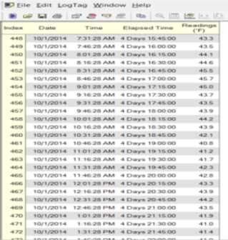
El resumen de las estadísticas diarias se muestra al hacer clic sobre “DAY SUMMARY”
En el caso de una excursión, este reporte le ayudará a determinar el periodo de tiempo en que las temperaturas se mantuvieron fuera del rango, mostrando la temperatura más alta y la más baja alcanzadas
Notes:
Clicking on “DAY SUMMARY” summarizes the daily statistics
In the case of an excursion, this report will help to determine the amount of time that temperatures were out of range showing the highest and lowest temperature reached

Slide 68
Solución de problemas
Notes:
Trouble-shooting the LogTag

Slide 69
Lecturas de temperatura de -199 grados
Podría ver esto en la pantalla si
el LogTag ha sido iniciado pero
no conectado al probe en un plazo de
5 minutos
Pare el LogTag y desconecte el
probe
Inicie el software en su computadora,
coloque el LogTag en la estación y haga clic sobre el
icono Configuration Wizard para reiniciar el LogTag
Cuando haya terminado, inicie el LogTag y conéctelo al probe antes de que pasen los 5 minutos del plazo de tiempo de demora
Notes:
-199 Degrees Temperature Readings - You may see this on your display if the LogTag has been started but not attached to the probe within the 5 minutes start delay
Stop the LogTag and unplug the probe
Open the software on your computer, place the LogTag in the dock and click on the Configuration Wizard icon to reset the LogTag
When finished, start the LogTag and attach it to the probe within the 5 minute delay time frame

Slide 70
Si no sucede nada cuando el LogTag sea insertado en la estación:
  Remueva el LogTag de la estación, inicie el software LogTag Analyzer, y luego recoloque el LogTag en la estación
Si el LogTag no es encontrado:
Cierre esta ventana, y luego reinserte el LogTag hasta que escuche un clic
Notes:
If nothing happens when the LogTag is inserted into the dock:
Remove the LogTag from the dock, open the LogTag Analyzer software, then replace the LogTag in the dock
If the LogTag is not found:
Close this window, then reinsert the LogTag until it clicks

Slide 71

Apoyo adicional
Notes:
Additional Support

Slide 72
Instrucciones detalladas sobre el uso del LogTag y el software podrán ser encontradas en el Manual del LogTag Analyzer
El manual puede encontrarlo al hacer clic sobre la opción “HELP” en el Software LogTag Analyzer
El soporte técnico se encuentra a su disposición en MicroDAQ.com, Ltd. También de lunes a viernes de 9:30AM a 4:30 PM, hora del este, mediante el teléfono 603-746-5524 o el correo electrónico support@microdaq.com
Notes:
Detailed instructions on using the LogTag and its’ software can be found in the LogTag Analyzer Manual
The manual can be found by clicking on the “HELP” option from inside the LogTag Analyzer Software
Technical support is available from MicroDAQ.com, Ltd. Monday – Friday from 9:30AM – 4:30 PM EST by calling 603-746-5524 or by email at: support@microdaq.com

