Slide 1
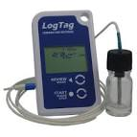

LogTag Training
January 2015
Notes:
Welcome to the new LogTag training designed to walk you through the installation process for your LogTag data logger.

Slide 2
LogTag Training Outline
Things Needed to Install the LogTag
Installing the LogTag Software
Configuring the LogTag
Preparing the LogTag
Starting the LogTag
Reviewing Daily Statistics
Alarm and Temperature Excursions
Analyzing Data from the LogTag
Trouble-Shooting the LogTag
Notes:
In this training session - we will cover the following: things needed to install the LogTag, preparing the LogTag, installing the LogTag software, configuring and starting the LogTag, reviewing daily statistics, alarm and temperature excursions, analyzing data from the LogTag and trouble-shooting the LogTag.

Slide 3

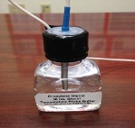

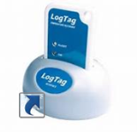
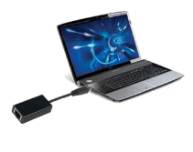
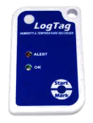
Things You Will Need When
Installing LogTags
Internet Access - Download Software
Probe/Vial – Small Bottle
Docking Station (Dock)
Desktop Shortcut
Connect to USB Port
Log Tag
Notes:
There are a few things you will need to have in order to successfully install your LogTag.
You will need to have internet access to download the LogTag software. Once the software is installed, you will see the LogTag icon on your desktop.
You’ll also need the Probe/vial and small bottle.
Be sure that you have a LogTag docking station.
You will need access to an USB port on your computer
And of course, you will need the LogTag data logger!

Slide 4
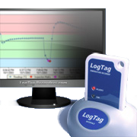
Installing the
LogTag Software
Notes:
Our first section of this training is going to cover installing the software.

Slide 5
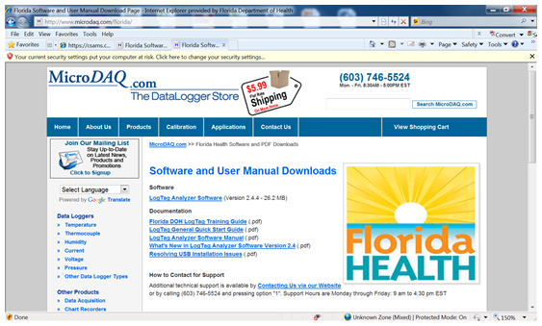

Log on to the internet and go to http://www.microdaq.com/florida/ to download the LogTag Analyzer Software
Notes:
Installing the LogTag software
Download the LogTag Analyzer Software by going to
www.microdaq.com/florida and then selecting the link for “LogTag Analyzer Software.

Slide 6
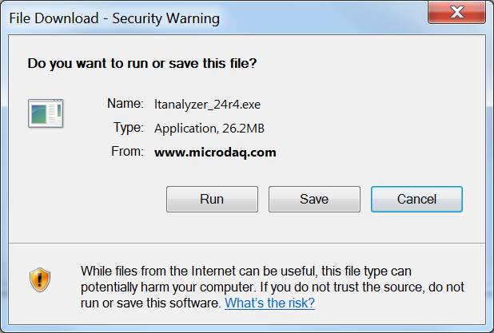
Then click “RUN” to load Analyzer Software
Notes:
Click “Run” to load the LogTag software.

Slide 7
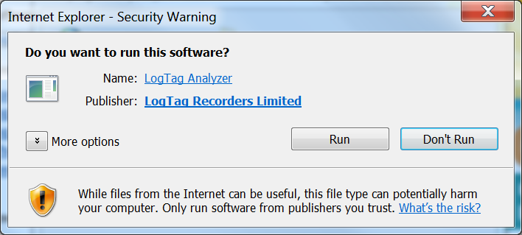
Next, click on “RUN”
Notes:
Click “Run” when asked “Do you want to run this software?”

Slide 8
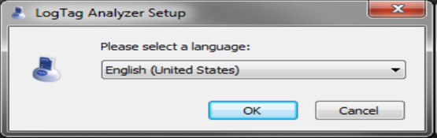
When the LogTag Analyzer Set-up opens - select your language and click “OK”
Notes:
When the LogTag Analyzer set-up opens, select the desired language from the drop-down menu then click on the “ok” button.

Slide 9
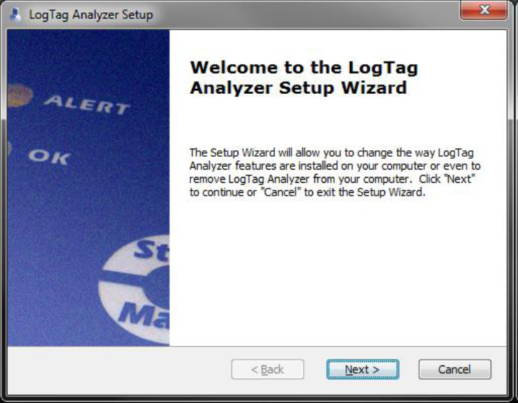
Click “NEXT” on the screen below
Notes:
Next you will see this screen that says “Welcome to the LogTag Analyzer Set-up Wizard.” Click the “Next button.”

Slide 10
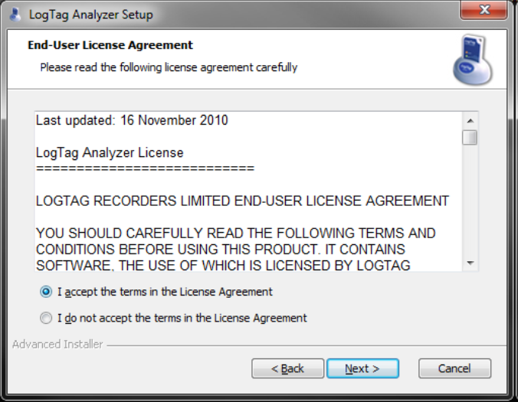
Select “I accept the terms in the license agreement”. Click “NEXT” to accept the End-User License Agreement
Notes:
Click to accept the terms of the licensing agreement and then select “Next.”

Slide 11
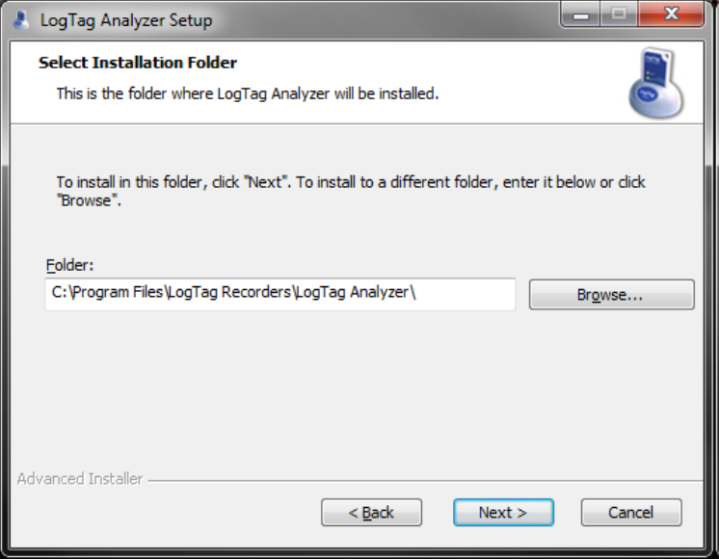
Accept the folder name that is populated or click on BROWSE to select another location. Click Next.
Notes:
The software will automatically generate and save in the location for you. If you want to change this location, you can click on the “browse” button and make your selection. Then, click “next.”

Slide 12
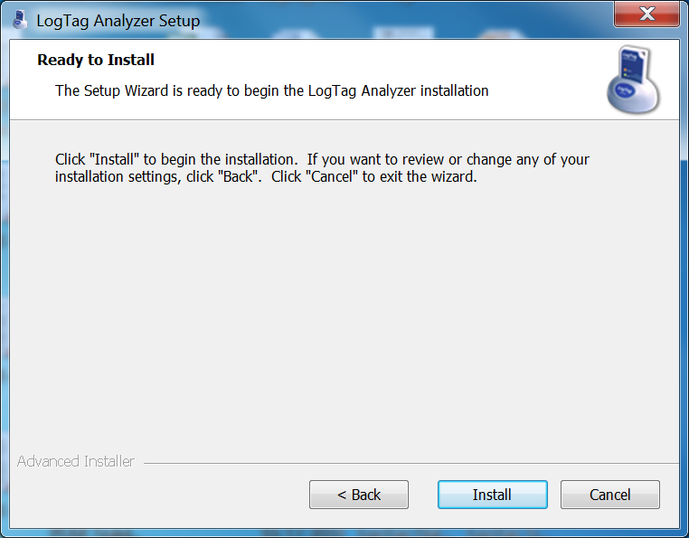
Click “INSTALL” to begin the LogTag Analyzer installation
Notes:
Now the setup wizard is ready to begin the LogTag Analyzer installation, begin this process by clicking the “install” button.

Slide 13
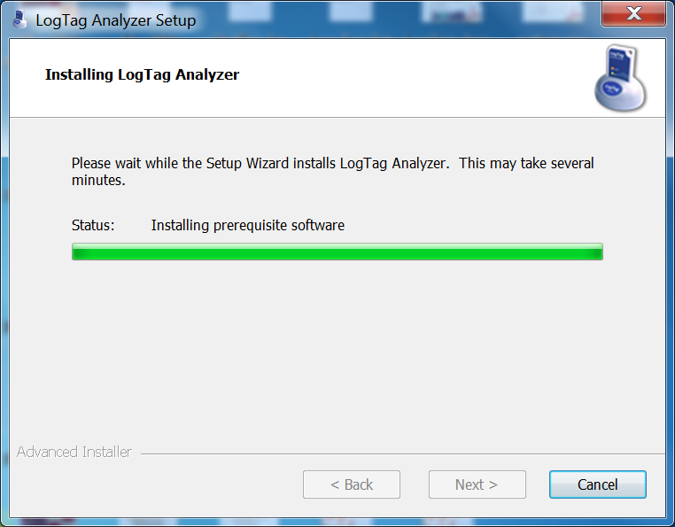
The progress of the installation is indicated by the green bar
Notes:
The software will begin to install at this point. The green bar will indicate the installation progress.

Slide 14
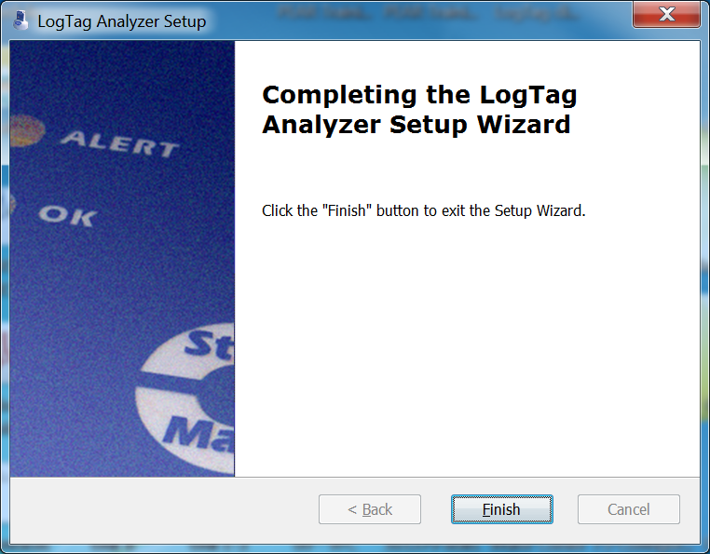
Click “FINISH”
Notes:
Click “finish” to exit the Setup Wizard.

Slide 15
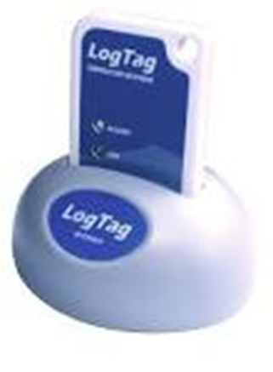
Look for the newly installed LogTag Analyzer Software icon on your desktop. If you do not see the icon there look in your “START” menu
Notes:
Look for the newly installed LogTag Analyzer Software icon on your desktop. If you do not find the icon on your desktop, look for it in the start menu.
VERY IMPORTANT! One thing I want to mention here. If you click on the icon and the software does not load, you must uninstall the LogTag software from the computer and reinstall it by going back over the previous steps of the installation process.

Slide 16
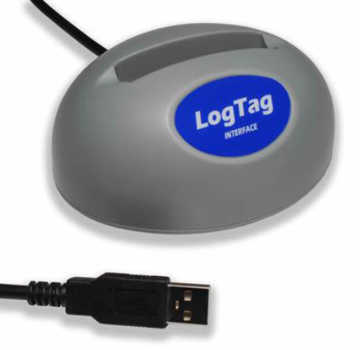
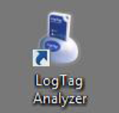
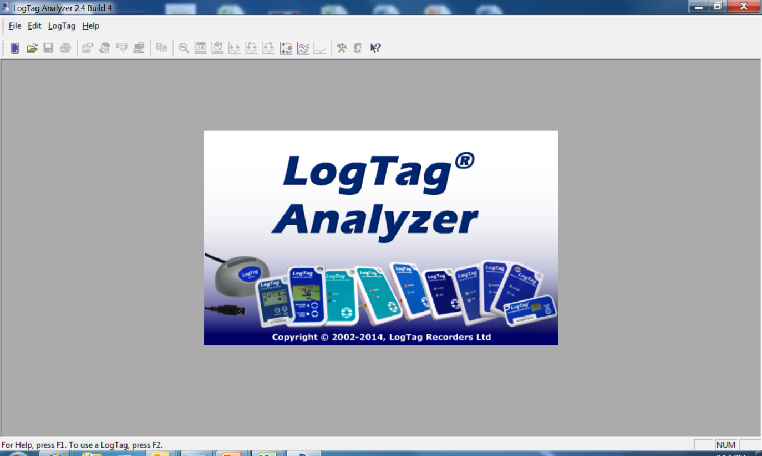
On your desktop, double-click on the newly installed shortcut for the LogTag Analyzer Software. If you do not see the LogTag Icon on your desktop, look in your “START” menu
Notes:
Locate the icon and double-click on it. Again, if you do not see it on your desktop, look in your start menu for “LogTag Analyzer.”.

Slide 17

Configuring the LogTag
Notes:
Now it is time to configure or “tie” the LogTag to the software.

Slide 18
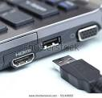

Notes:
Insert the USB end of the docking station into the USB port on the computer or laptop. After plugging in the docking station for the first time, the system will install drivers for the device and should notify you as this occurs. Please allow a moment for this to complete.”

Slide 19

Notes:
Insert the LogTag into the docking station with the digital screen facing forward, until it clicks.

Slide 20
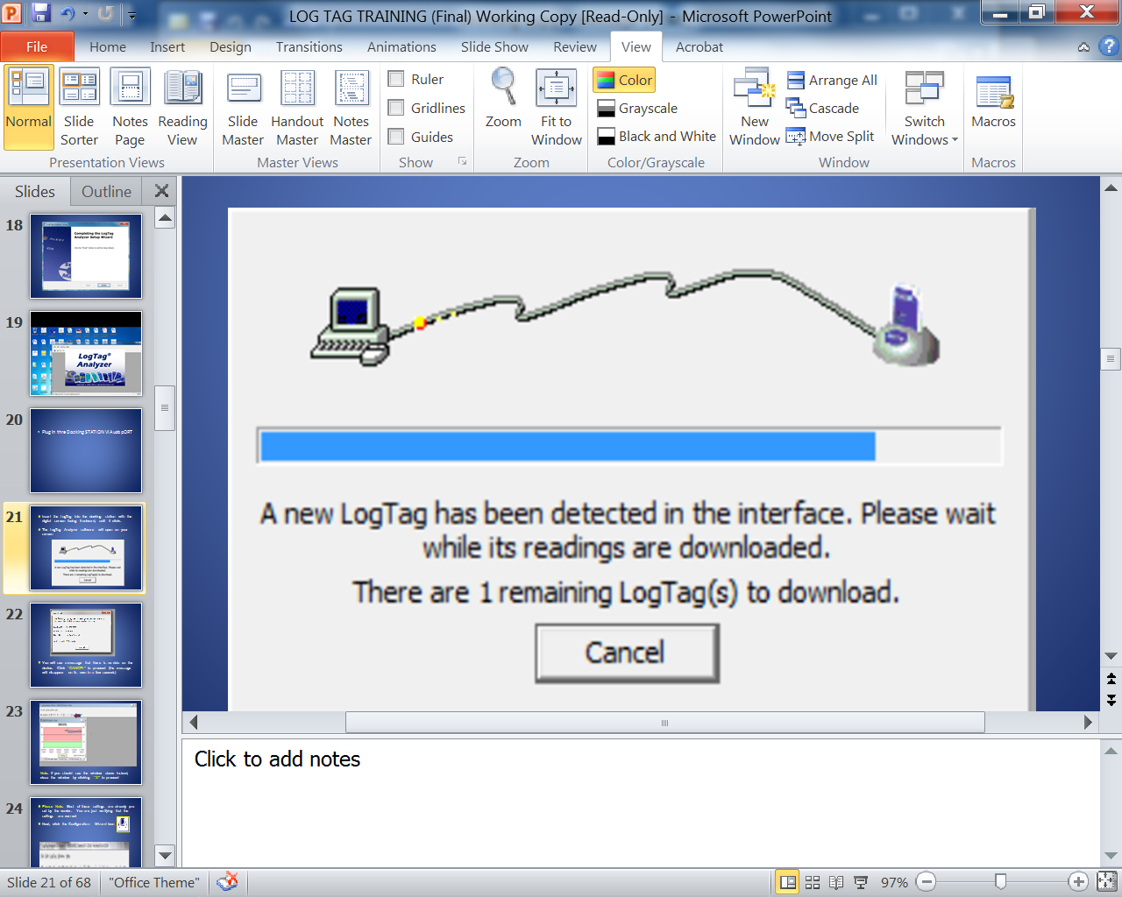
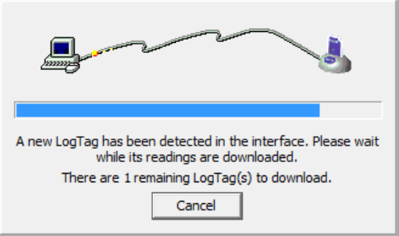
Insert the LogTag into the docking station with the digital screen facing frontward, until it clicks
The LogTag Analyzer software will open on your screen
Notes:
The picture on this screen is an indicator that the docking station is connected to the computer.

Slide 21
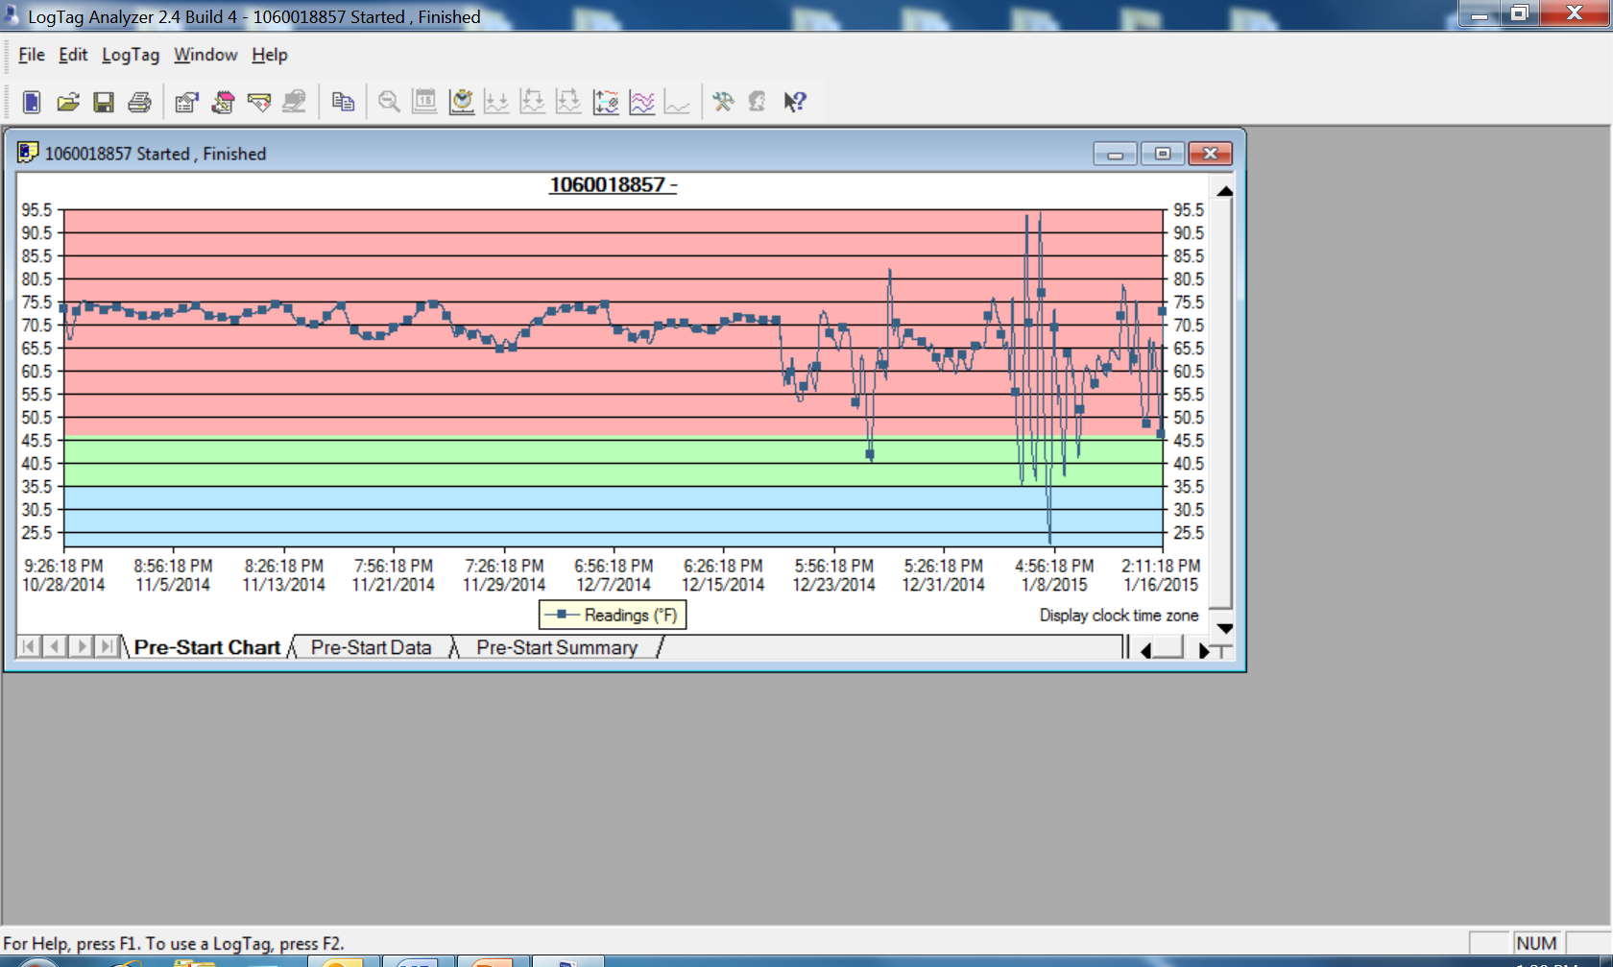

Slide 22
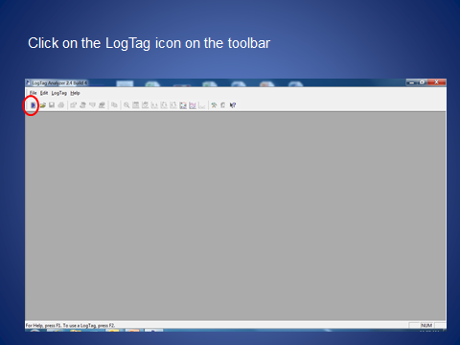
Notes:
Now click on the LogTag icon in the upper left corner of your screen – it looks like a tiny cell phone.

Slide 23
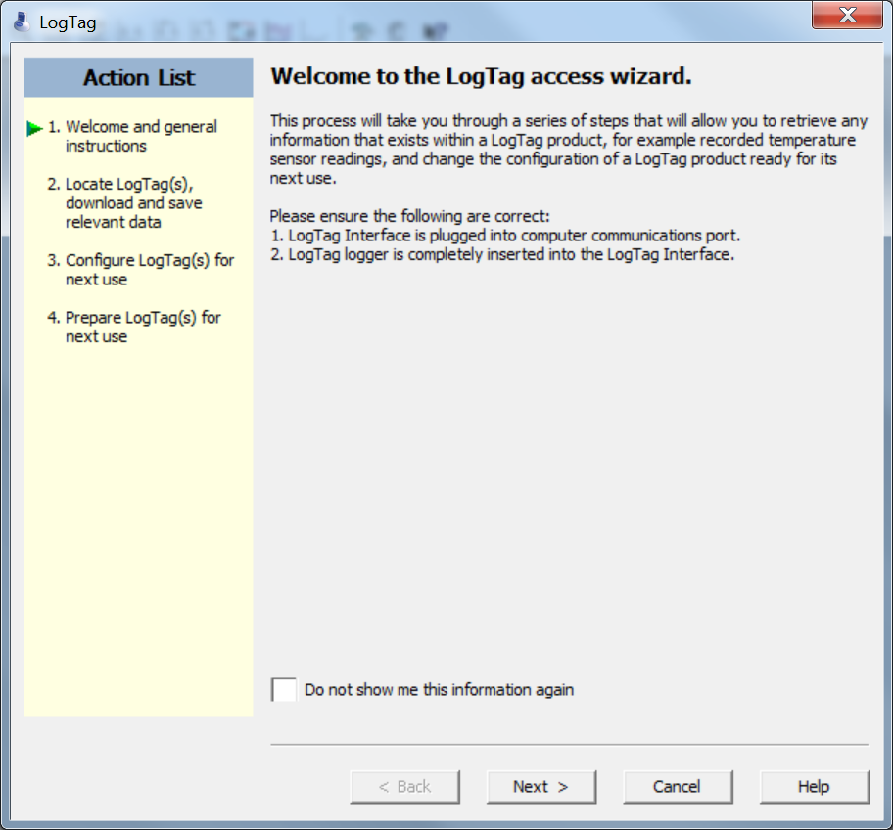
Click “NEXT”
Notes:
When this screen comes up – click “next”

Slide 24
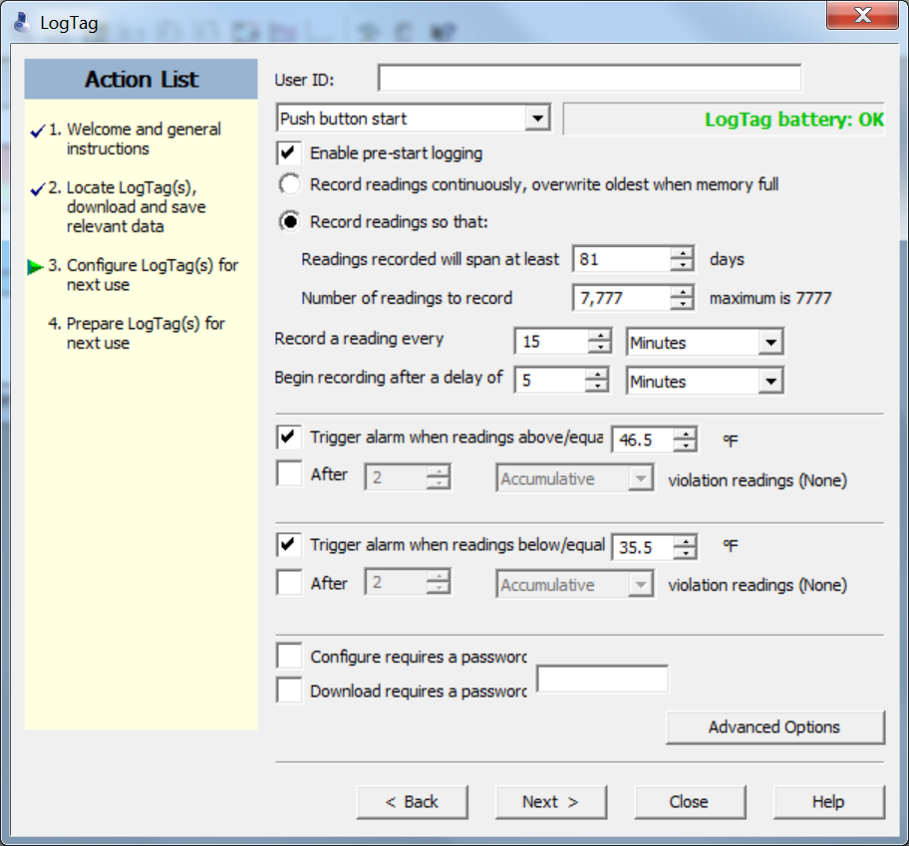
Notes:
You should have a screen now that looks like this one.
The first thing that needs to be done is you will need to give it a User ID on the first line indicated by the red arrow on your screen.
When assigning the User ID, use the format of PIN-FREEZER (or whatever name such as “breakroom” or just something easy to remember or PIN-REFRIGERATOR and a number at the end if you have more than one of that type of unit. It is imperative that the names of the unit are identical to what you current in Florida SHOTS or your data will not upload.
Everything else on this page is pre-configured – just check to ensure that your page is exactly like the page appearing on the screen.
Be sure and leave the password options blank – and DO NOT click on “next” yet. Now, click on “Advanced Options.”

Slide 25
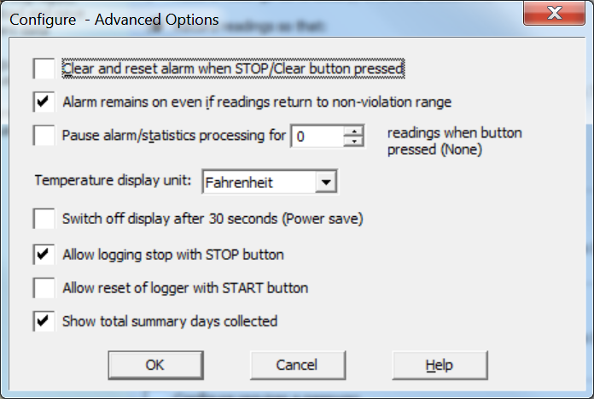
Notes:
On the Configure – Advanced Options screen – the settings are pre-configured. Select “Fahrenheit” for the Temperature Display Unit and then click on the “ok” button.

Slide 26
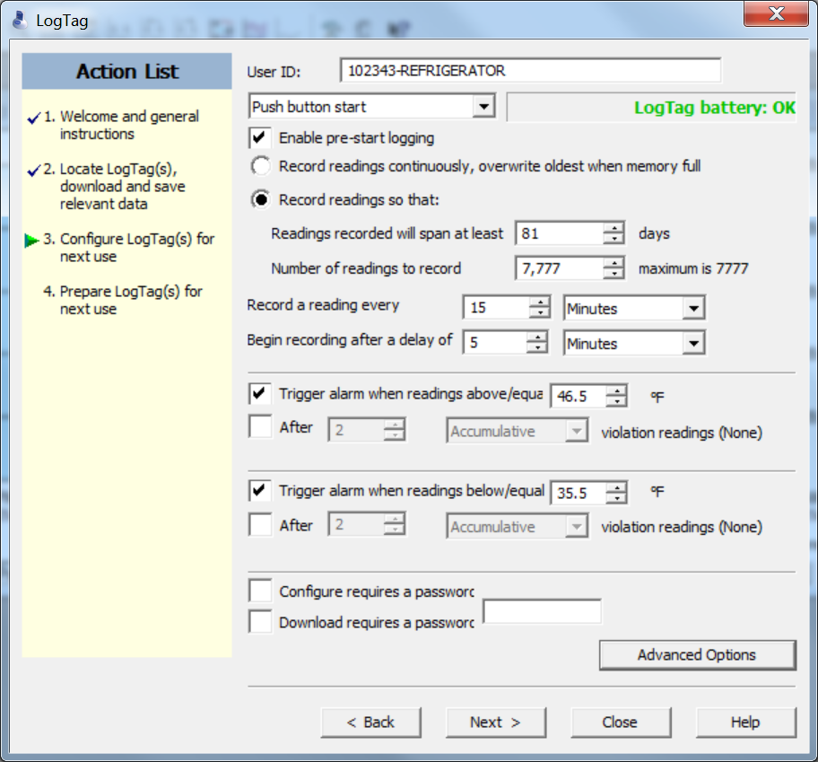
Notes:
Click the “next” button.

Slide 27
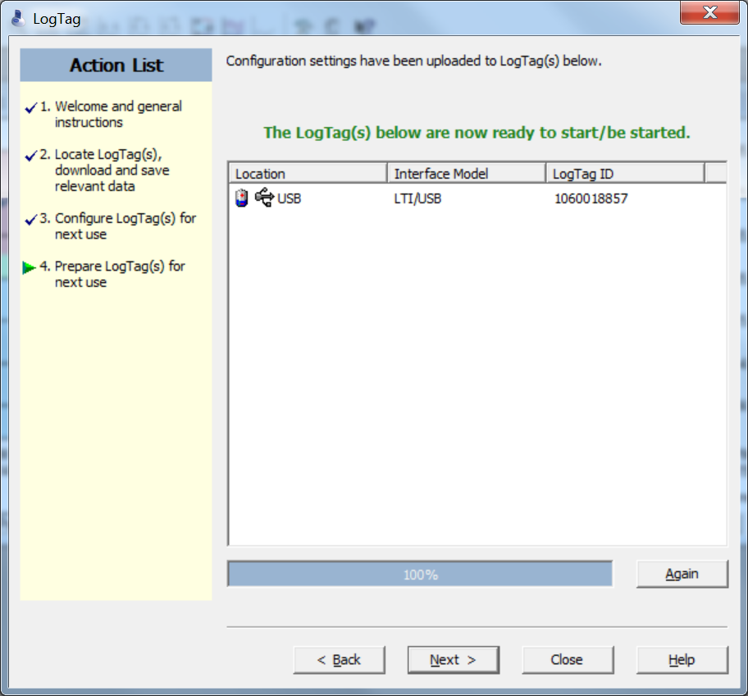

Slide 28
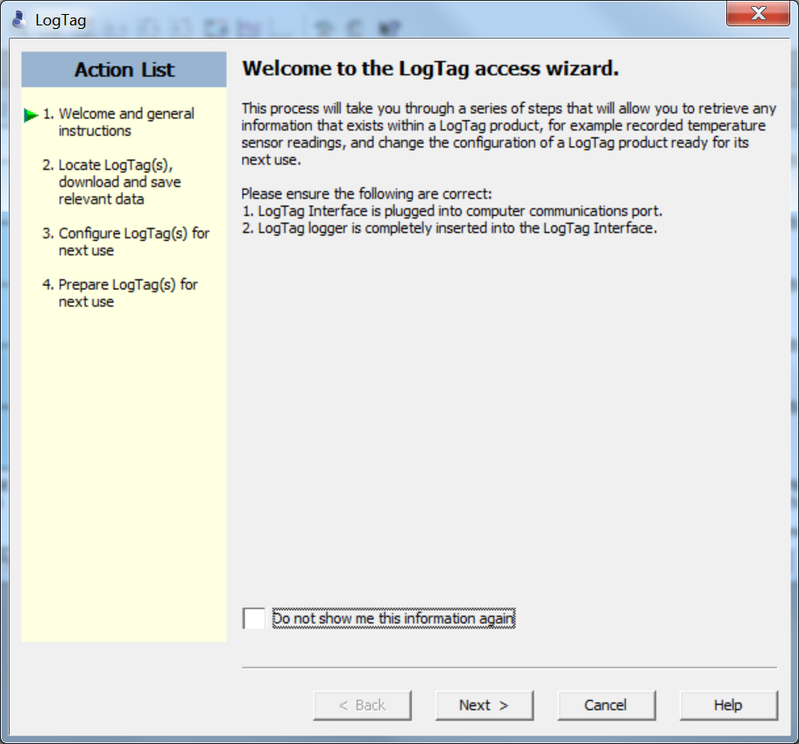
Notes:
Then click “next” to continue.

Slide 29
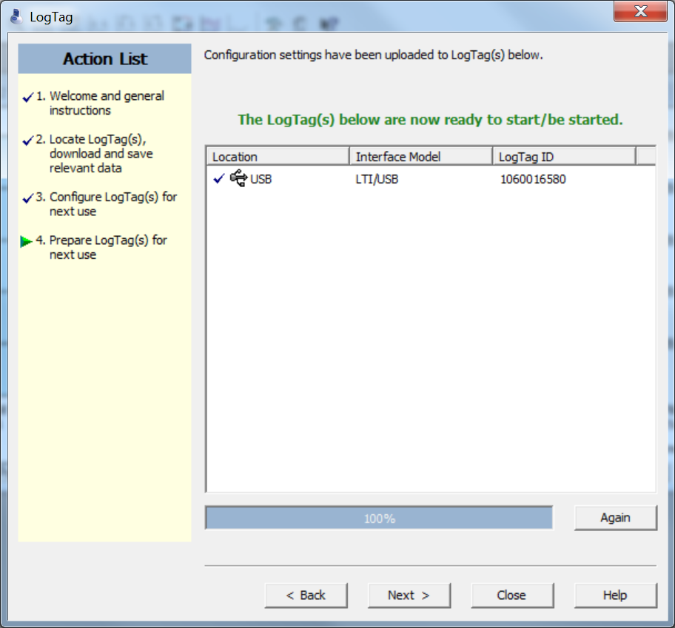
Notes:
Click “NEXT” and on the next screen select “CLOSE”. Now would be a good time to any other LogTag devices which need to be set-up for use. This configuration process is also used to “reset” a LogTag device after each successful download.

Slide 30
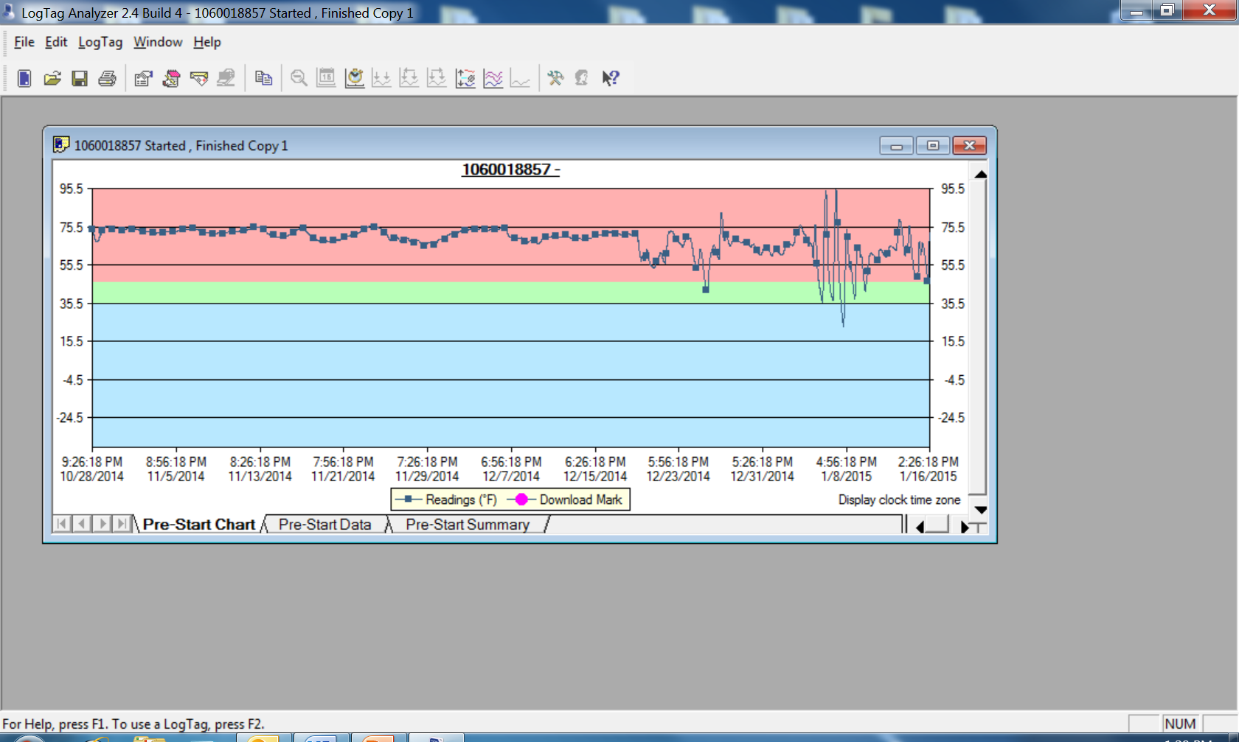

Slide 31
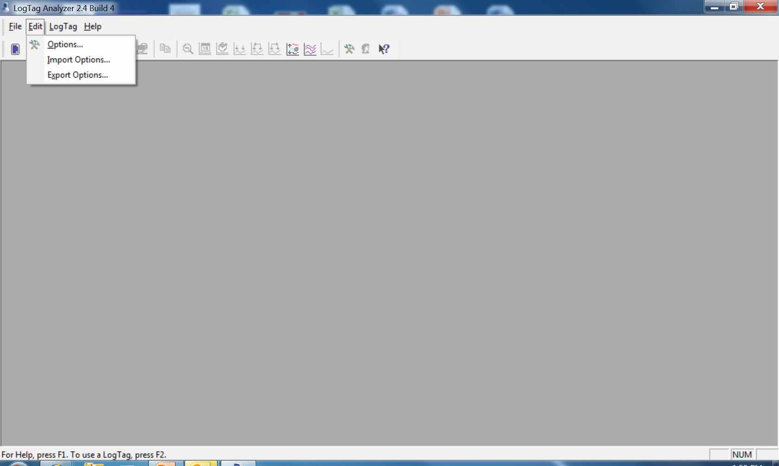
Notes:
Now from the menu bar at the top of this page, click “edit” then select “options.”

Slide 32
At the main menu, click on “EDIT”, then select “OPTIONS”
At the menu on the left, click on “GENERAL SETTINGS”
Show temperatures in “FAHRENHEIT”
Notes:
A list will appear on the left, click on “general settings” which appears at the top of the list and confirm the “show temperatures” and select “Fahrenheit.”

Slide 33
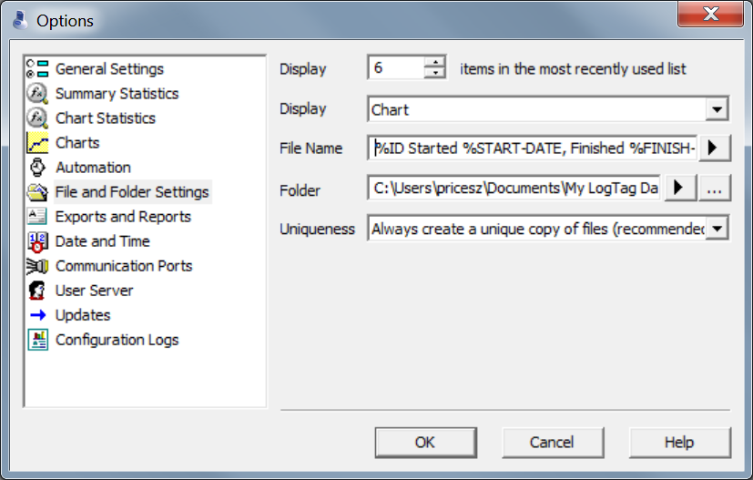
At the menu on the left, click on “FILE AND FOLDER SETTINGS”
On the “FILE” line type the following:
%ID %STARTED %START-DATE, Finished %FINISH-DATE
Notes:
Then move down to the “File and Folder Setting” on the “file” line type
%ID %STARTED %START-DATE, Finished %FINISH-DATE
Now this file name is a little different than the first version in the power point put together by Microdaq. I spoke with IT in our office and he said that either one will work. I would say not to worry about those that have been set up using the old version because this will not cause a problem with uploading to Florida SHOTS. Going forward, this is what should be used – for consistency among the field staff.

Slide 34


On the “FOLDER” line, you have to select a place where the user will save the LogTag data files
This file needs to be accessible to multiple users, so a folder on a shared drive is ideal. If there are multiple users for the same computer, the desktop would serve the purpose. Click on the “…” button
Select the drive where the LogTag files will be stored. If a LogTag folder already exists there, click on the “…” button
Notes:
On the “Folder” line, select a place where the user will save the LogTag data files.
It is VERY important to note that the place selected to save the LogTag data files needs to be accessible to multiple users – so a shared folder is ideal.
Then select the drive where the LogTag data files will be stored. If a LogTag already exists there, click on the “…” button, a “locate folder” box will appear.

Slide 35
Select the drive where the LogTag files will be stored. If a LogTag folder already exists there, click once to select it, then click “OK”
If no folder exists, click on “MAKE NEW FOLDER”, name it LogTag, then click “OK”
Notes:
From that list, you may now select the drive where the LogTag files will be stored. If a folder already exists – click once to select it then click on “ok.”
If the folder was not yet created, click on “make new folder”, name it LogTag, then click “ok.”

Slide 36
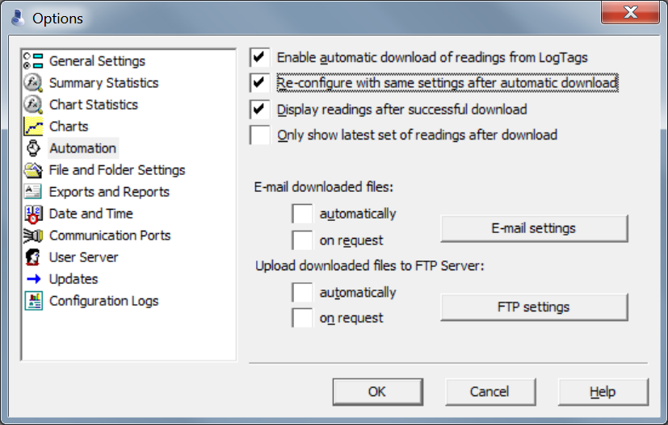
Notes:
Click the second box “Re-configure with same settings after automatic download”, then click on “OK”.

Slide 37
Setting Up
User Profiles

Slide 38
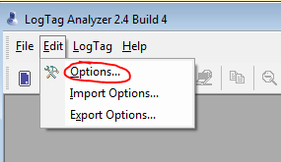
USER PROFILES:
Open LogTag Analyzer software
Choose Edit->Options
Notes:
Open the LogTag software, then choose “edit” then “options”

Slide 39
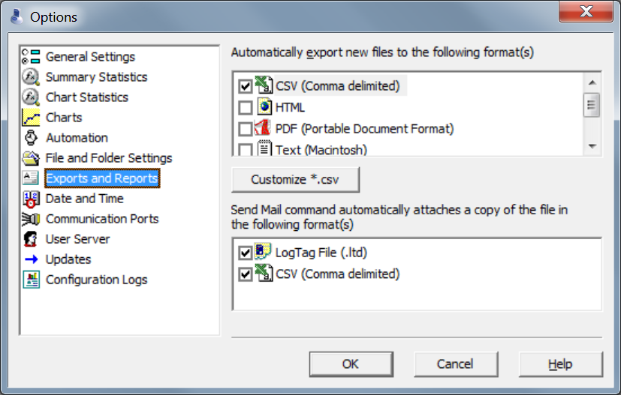
Choose Exports and Reports
Click Customize *.csv button
Notes:
Click on “Exports and Reports”, check the box next to “CSV” then the “customize CSV” button.

Slide 40
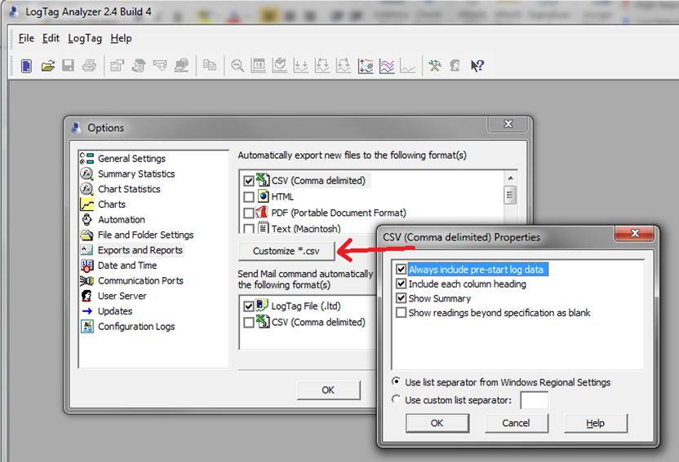

Slide 41

Preparing the LogTag
Notes:
Preparing the LogTag

Slide 42
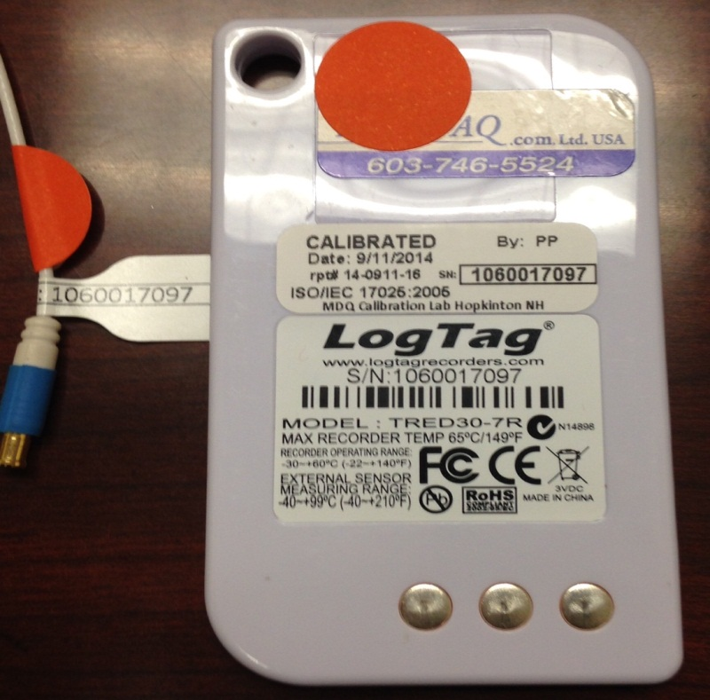

IMPORTANT: Match the Probe & LogTag by serial numbers and color coded stickers. Plug the Probe into the LogTag
Notes:
It is very important that the serial numbers on the LogTag and the probe match. There are color-coded dots that will assist you in matching up the LogTag and probe. Once the serial numbers are verified, plug the probe into the LogTag.

Slide 43
Place the vial in a plastic tray (if wire rack) in the center of the fridge/freezer unit and secure with tape or Velcro
Run the probe cable through the hinge on the side of the door
Allow probe/vial to “normalize” in fridge/ freezer for 1 1/2 to 2 hours before starting the LogTag
Notes:
Next, place the vial in a plastic tray – if placing it on a wire rack – and put it in the center of the middle rack of the unit and secure with tape or Velcro.
Run the probe cable through the hinge side of the door.
It is important to be sure and allow the probe/vial to normalize and approximate vaccine temperatures in the unit for 1 ½ - 2 hours before starting the LogTag.

Slide 44
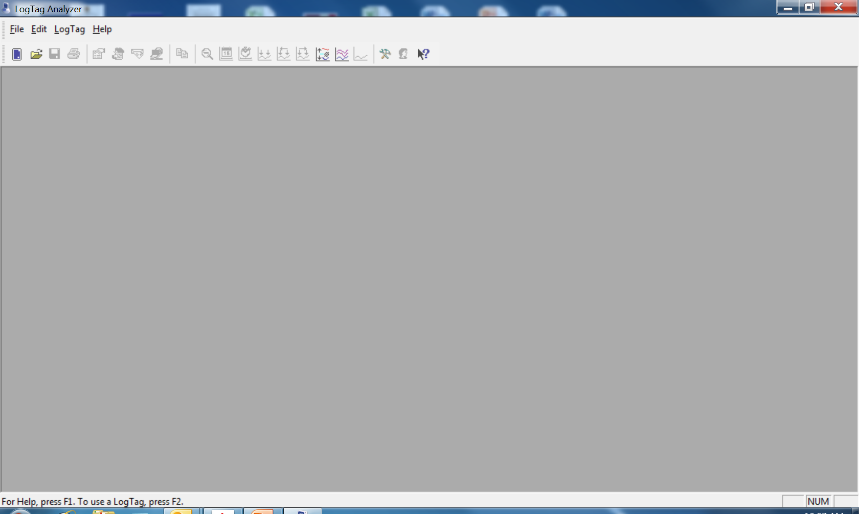
Now the LogTag is fully configured and ready to be used. Click “OK” and remove LogTag from the docking station
Click the “X” in the upper right corner of the page to close
Notes:
The LogTag is now fully configured and ready to be used. Click “ok” and remove the LogTag from the docking station.
Click the “X” in the upper right corner to close this page.

Slide 45
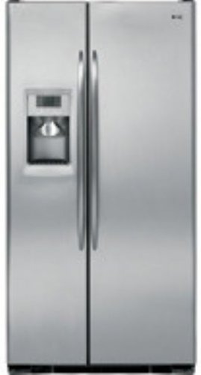
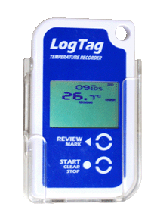
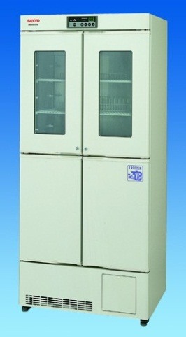
Identify the desired mounting location outside of fridge/ freezer
Be sure the place you select is within reach of both fridge/freezer probes and is easily accessible
Attach LTI-MOUNT (clear plastic mount) using the included double-sided tape (located in each mount)
Slide the LogTag into the mount WITHOUT the probe attached
Notes:
Decide the desired mounting location on the outside of the unit, ensuring that the probe will reach and that the mounting location of the LogTag is easily accessible.
Attach the clear plastic LTI-mount using double-sided tape.
Then, slide the LogTag into the mount WITHOUT the probe attached.

Slide 46
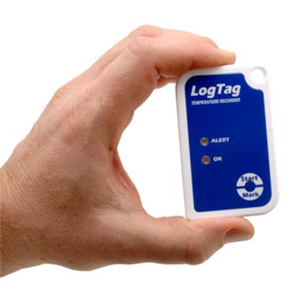
Starting the LogTag
Notes:
This section is about “Starting the LogTag.”

Slide 47
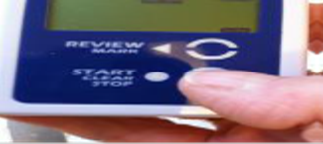
Once configured, the display should read “READY”
Press and hold the “START” button. Release when “STARTING” stops flashing
Notes:
The LogTag is now configured and should read “ready.”
Press and hold the “start” button, then release the button when “starting” stops flashing on the screen.

Slide 48
There is a 5 minute delay before the LogTag on the storage unit begins recording. Return the LogTag to its’ holder and plug in the probe
Notes:
It is important to note that there is a 5 minute delay before the LogTag begins recording. This is a good time to return the LogTag to its holder and plug in the probe.

Slide 49
Your log should show “Recording“ on the display
Press the review button once (top)
The LogTag will display today’s
maximum temperature
(Day 00=today)
Notes:
On the LogTag display, you will see “recording.” Press the “review” button at the top once.
The LogTag will display today’s max temperature.

Slide 50
Press the “REVIEW” button once again and the display will show today’s minimum temperature
When you’re done reviewing temperatures, press the “STOP” button once
Notes:
To display today’s minimum temperature, press the “review” button once again. When you are done reviewing temperatures, press the “stop” button.

Slide 51
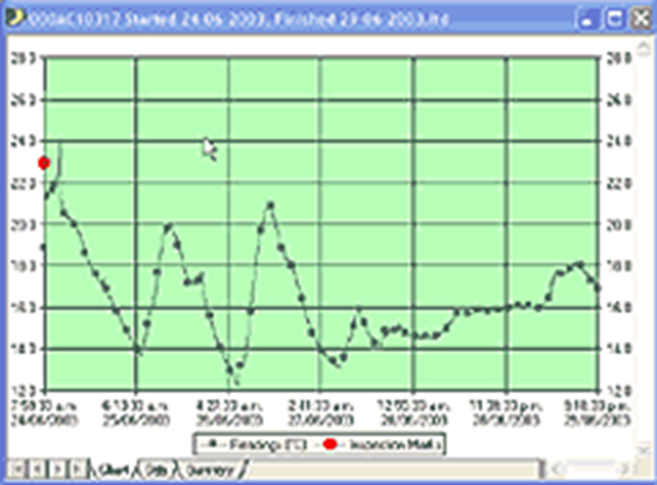

Reviewing Daily
Statistics

Slide 52
The LogTag should still show “RECORDING”
Press the “REVIEW” button to place an “Inspection Mark” on the record
This shows you have reviewed the temperature readings for that day
This action should be done twice daily for each LogTag. This action replaces the need to keep paper temperature logs
You can review the minimum and maximum temperatures for up to the previous 30 days recorded
Notes:
When reviewing the daily statistics, the LogTag should still show “recording”.
By pressing the “review” button you are placing an “inspection mark” on the record. This shows you have reviewed the temperature readings for that day.
This should be done twice daily for each LogTag.
I need to mention something very important here. When recording an inspection mark right before docking - you MUST hit review, wait 15 minutes, stop it (to where stopped is no longer flashing) before disconnecting the probe and place in the docking station - or your last inspection marks will not record and the LogTag will generate an error message which will prevent it from uploading into Florida SHOTS.
Attach the LogTag to the probe BEFORE you hit START (by holding the START button until the word START is no longer flashing and the word STARTED holds steady on the display) to begin taking temperatures again with the LogTag.
You are required to keep paper logs and/or temperature readings entered into Florida SHOTS for three years. Once the twice daily temperatures are entered into Florida SHOTS utilizing either a data logger or manual entry methods, going forward – you will not have to maintain the paper logs anymore. Remember that you must have three years of the paper logs or twice daily temperature readings entered into Florida SHOTS – OR a combination of the two. As time passes and temperature readings are entered into Florida SHOTS, you will be able to begin to discard the older paper logs gradually – as you are required to just keep the last 3 years.
You can review the minimum and maximum temperatures for up to the previous 30 days recorded.

Slide 53
After reviewing the current day’s minimum and maximum temperatures, pressing the “REVIEW” button once again will show yesterday’s (Day -1) maximum temperature. Any out of range readings will be indicated
Notes:
After reviewing the current day’s minimum and maximum temperatures, pressing the “REVIEW” button once again will show yesterday’s (Day -1) maximum temperature. Any out of range readings will be indicated.

Slide 54
Press “REVIEW” again and it will show yesterday’s (Day-1) minimum temperature reading
Notes:
Then, press “review.”

Slide 55

Pressing “REVIEW” again will show the maximum reading for 2 days ago (Day -2) etc…
Press the “STOP” button at any time to exit REVIEW Mode
Notes:
By pressing “review” again, the LogTag will display the maximum reading for 2 days ago. You can press the “stop” button at any time to exit “review mode”

Slide 56
How to View/Save Data
Slide LogTag out of mount
Press and hold the “START/CLEAR/STOP button
When “stopped” quits flashing, release button and you will see “stopped” on the screen
Unplug the probe
It is important that the LogTag and probe serial numbers match
Open LogTag software and place the LogTag into the docking station
Notes:
To view/save LogTag data – first, slide the LogTag out of the mount.
Stop the recording process by pressing and holding the “start/clear/stop button.
When “stopped” is no longer flashing, release the button and you should see “stopped” on the screen.
Carefully unplug the probe from the LogTag.
It is important that the LogTag and probe serial numbers match
Open LogTag software and place the LogTag into the docking station

Slide 57
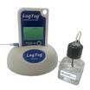
Alarms & Temperature Excursions
Notes:
Alarms & Temperature Excursions

Slide 58

Your LogTag has been configured to record temperatures for a specific unit, either R/F
When a recorded temperature is above or below the recommend temperature range for the unit, the LogTag displays an alarm warning
The word ALARM flashes on the LogTag’s screen
An up arrow indicates the temperature is too warm for the unit
A down arrow indicates the temperatures is too cool
Notes:
Your LogTag has been configured to record temperatures for a specific unit, either R/F
When a recorded temperature is above or below the recommend temperature range for the unit, the LogTag displays an alarm warning
The word ALARM flashes on the LogTag’s screen
The up arrow indicates the temperature is too warm for the unit
A down arrow indicates the temperatures is too cool

Slide 59
  Once the temperature has returned to acceptable range, you can clear the alarm
  Press and hold the STOP button until ALARM stops flashing
  Release the STOP button within 2 seconds
  The word ALARM should disappear from the screen, but TODAY will appear, indicating that there was a temperature excursion today
Notes:
Once the temperature has returned to acceptable range, you can clear the alarm
Press and hold the STOP button until ALARM stops flashing
Release the STOP button within 2 seconds
The word ALARM should disappear from the screen, but TODAY will appear, indicating that there was a temperature excursion today

Slide 60
Tomorrow, there will be a message showing “1-day”, indicating that there was an alarm yesterday
Notes:
Tomorrow, there will be a message showing “1-day”, indicating that there was an alarm yesterday

Slide 61
This message will continue to show for up to 30 days, indicating all the alarms that occurred during that 30-day time period. (In the example below, there were several alarms that occurred: yesterday (1-day), 8 days ago, 20 days ago, 21 days ago and 26 days ago
Notes:
This message will continue to show for up to 30 days, indicating all the alarms that occurred during that 30-day time period. (In this below, there were several alarms that occurred: yesterday (1-day), 8 days ago, 20 days ago, 21 days ago and 26 days ago

Slide 62
The value displayed is indicated by the following:
  TIME = Displaying Current Time (READY & RECORDING modes)
  TIME DELAY = Displaying remaining time to recording start when a DELAYED START time has been configured (STARTING MODE)
Notes:
The value displayed is indicated by the following:
TIME = Displaying Current Time (READY & RECORDING modes)
TIME DELAY = Displaying remaining time to recording start when a DELAYED START time has been configured (STARTING MODE)

Slide 63
DURATION = Displaying duration of a given MAX/MIN statistic above/below the limits in a given day (REVIEW MODE)
Battery status – Performs battery test hourly
Notes:
DURATION = Displaying duration of a given MAX/MIN statistic above/below the limits in a given day (REVIEW MODE)
Battery status – Performs battery test hourly

Slide 64
When the LogTag is inserted into the dock it’s data is automatically downloaded and saved to your computer
By default, a chart is displayed showing the time period that the LogTag was active
Recordings from 9/26/14 through 10/1/14 is indicated
Notes:
When the LogTag is inserted into the dock it’s data is automatically downloaded and saved to your computer
By default, a chart is displayed showing the time period that the LogTag was active

Slide 65
The blue line is charting all of the recorded temperatures during this period
The temperature range is shown on the left
Times and dates are along the bottom
You can hover with your mouse over any point on the graph to see the time and temperature recorded
You can change the display by clicking on one of the tabs on the bottom, “CHART” is currently selected
Notes:
The blue line is charting all of the recorded temperatures during this period
The temperature range is shown on the left
Times and dates are along the bottom
You can hover with your mouse over any point on the graph to see the time and temperature recorded

Slide 66
If you click on “REPORT” you will see a one-page report that summarizes all of the information for this time period.
Clicking “DATA” will give you a detailed report of each recorded temperature reading
The temperature captured every 15 minutes is shown in this report as pre-set in the LogTag
Notes:
If you click on “REPORT” you will see a one-page report that summarizes all of the information for this time period.
Clicking “DATA” will give you a detailed report of each recorded temperature reading
The temperature captured every 15 minutes is shown in this report as pre-set in the LogTag

Slide 67
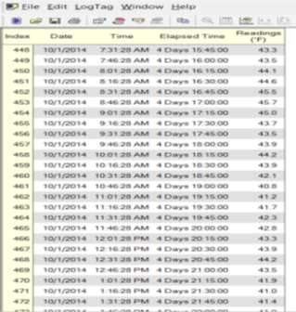
Clicking on “DAY SUMMARY” summarizes the daily statistics
In the case of an excursion, this report will help to determine the amount of time that temperatures were out of range showing the highest and lowest temperature reached
Notes:
Clicking on “DAY SUMMARY” summarizes the daily statistics
In the case of an excursion, this report will help to determine the amount of time that temperatures were out of range showing the highest and lowest temperature reached

Slide 68
Trouble-Shooting
Notes:
Trouble-shooting the LogTag

Slide 69
-199 Degrees Temperature Readings
You may see this on your display
if the LogTag has been started but
not attached to the probe within
the 5 minutes start delay
Stop the LogTag and unplug the
probe
Open the software on your
computer, place the LogTag in the dock and click on the
Configuration Wizard icon to reset the LogTag
When finished, start the LogTag and attach it to the probe within the 5 minute delay time frame
Notes:
-199 Degrees Temperature Readings - You may see this on your display if the LogTag has been started but not attached to the probe within the 5 minutes start delay
Stop the LogTag and unplug the probe
Open the software on your computer, place the LogTag in the dock and click on the Configuration Wizard icon to reset the LogTag
When finished, start the LogTag and attach it to the probe within the 5 minute delay time frame

Slide 70
If nothing happens when the LogTag is inserted into the dock:
  Remove the LogTag from the dock, open the LogTag Analyzer software, then replace the LogTag in the dock
If the LogTag is not found:
Close this window, then reinsert the LogTag until it clicks
Notes:
If nothing happens when the LogTag is inserted into the dock:
Remove the LogTag from the dock, open the LogTag Analyzer software, then replace the LogTag in the dock
If the LogTag is not found:
Close this window, then reinsert the LogTag until it clicks

Slide 71

Additional Support
Notes:
Additional Support

Slide 72
Detailed instructions on using the LogTag and its’ software can be found in the LogTag Analyzer Manual
The manual can be found by clicking on the “HELP” option from inside the LogTag Analyzer Software
Technical support is available from MicroDAQ.com, Ltd. Monday – Friday from 9:30AM – 4:30 PM EST by calling 603-746-5524 or by email at: support@microdaq.com
Notes:
Detailed instructions on using the LogTag and its’ software can be found in the LogTag Analyzer Manual
The manual can be found by clicking on the “HELP” option from inside the LogTag Analyzer Software
Technical support is available from MicroDAQ.com, Ltd. Monday – Friday from 9:30AM – 4:30 PM EST by calling 603-746-5524 or by email at: support@microdaq.com

